Slide 1
Introduction to Infectious Diseases in a Global Health Setting
BIOS27815: Infectious Diseases
UChicago Center in Paris
Paris, France
January 2025

Slide 2
Goals for this lecture
To explain what we’re doing here
To introduce global health
To introduce infectious disease
To introduce methods for the study of infectious diseases

Slide 3
Goals for this lecture
To explain what we’re doing here
To introduce global health
To introduce infectious disease
To introduce methods for the study of infectious diseases

Slide 4
Goals for this lecture
To explain what we’re doing here
To introduce global health
To introduce infectious disease
To introduce methods for the study of infectious diseases

Slide 5
Goals for this lecture
To explain what we’re doing here
To introduce global health
To introduce infectious disease
To introduce methods for the study of infectious diseases

Slide 6
Goals for this lecture
To explain what we’re doing here
To introduce global health
To introduce infectious disease
To introduce methods for the study of infectious diseases

Slide 7
What is global health?

Slide 8
What is global health?
the health of the populations in the worldwide context (WHO 2006)
an area of study, research, and practice that places a priority on improving health and achieving equity in health for all people worldwide
focus on problems that transcend national borders or have a global political and economic impact are often emphasized (reduction of disparities, protection against global threats)
e.g. COVID (vaccination), polio eradication
Different from international health, the branch of public health focused on foreign aid efforts led by high income countries to improve health improve health in low and middle income countries (LMICs)

Slide 9
What is global health?
the health of the populations in the worldwide context (WHO 2006)
an area of study, research, and practice that places a priority on improving health and achieving equity in health for all people worldwide
focus on problems that transcend national borders or have a global political and economic impact are often emphasized (reduction of disparities, protection against global threats)
e.g. COVID (vaccination), polio eradication
Different from international health, the branch of public health focused on foreign aid efforts led by high income countries to improve health improve health in low- and middle-income countries (LMICs)

Slide 10
What is global health?
the health of the populations in the worldwide context (WHO 2006)
an area of study, research, and practice that places a priority on improving health and achieving equity in health for all people worldwide
focus on problems that transcend national borders or have a global political and economic impact are often emphasized (reduction of disparities, protection against global threats)
e.g. COVID (vaccination), polio eradication
Different from international health, the branch of public health focused on foreign aid efforts led by high income countries to improve health improve health in low- and middle-income countries (LMICs)

Slide 11
What is global health?
the health of the populations in the worldwide context (WHO 2006)
an area of study, research, and practice that places a priority on improving health and achieving equity in health for all people worldwide
focus on problems that transcend national borders or have a global political and economic impact are often emphasized (reduction of disparities, protection against global threats)
e.g. COVID (vaccination), polio eradication
Different from international health, the branch of public health focused on foreign aid efforts led by high income countries to improve health improve health in low- and middle-income countries (LMICs)

Slide 12
What are the major threats to global health? (e.g. globally, the leading causes of death)

Slide 15
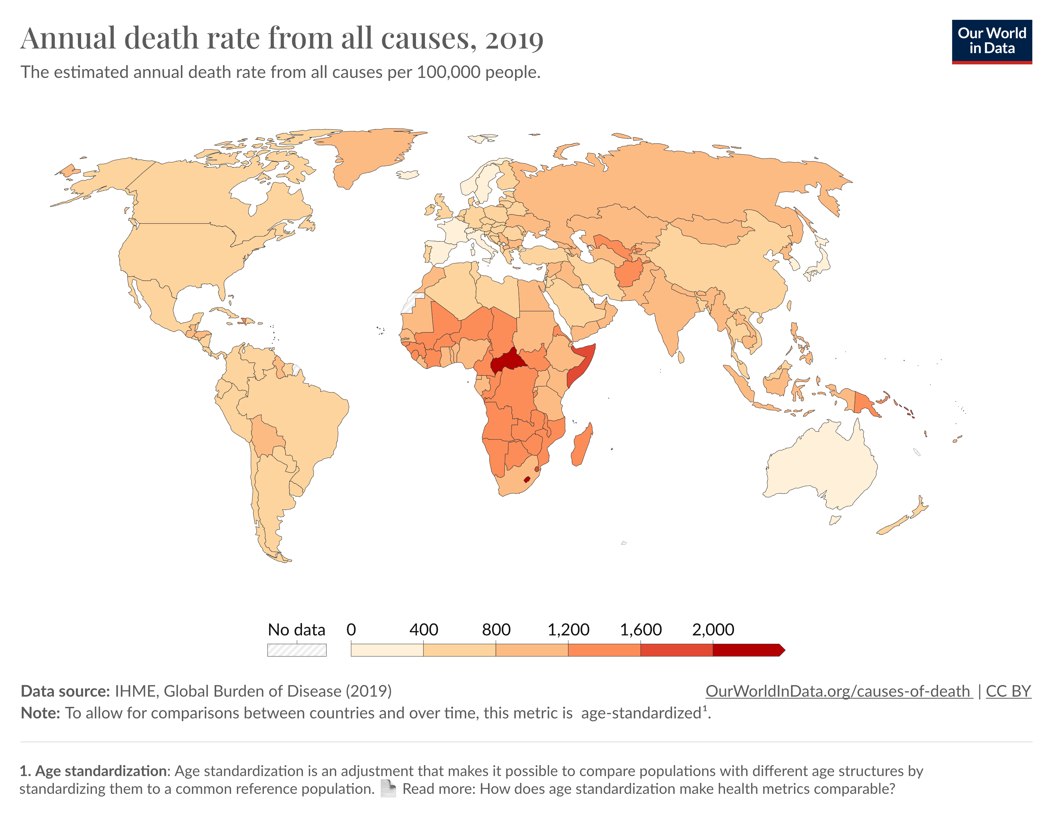
Global death rates are far from equitable.

Slide 16
Global death rates are far from equitable.
We’re here to learn how the field of ‘global health’ can intervene to reverse these trends.

Slide 17
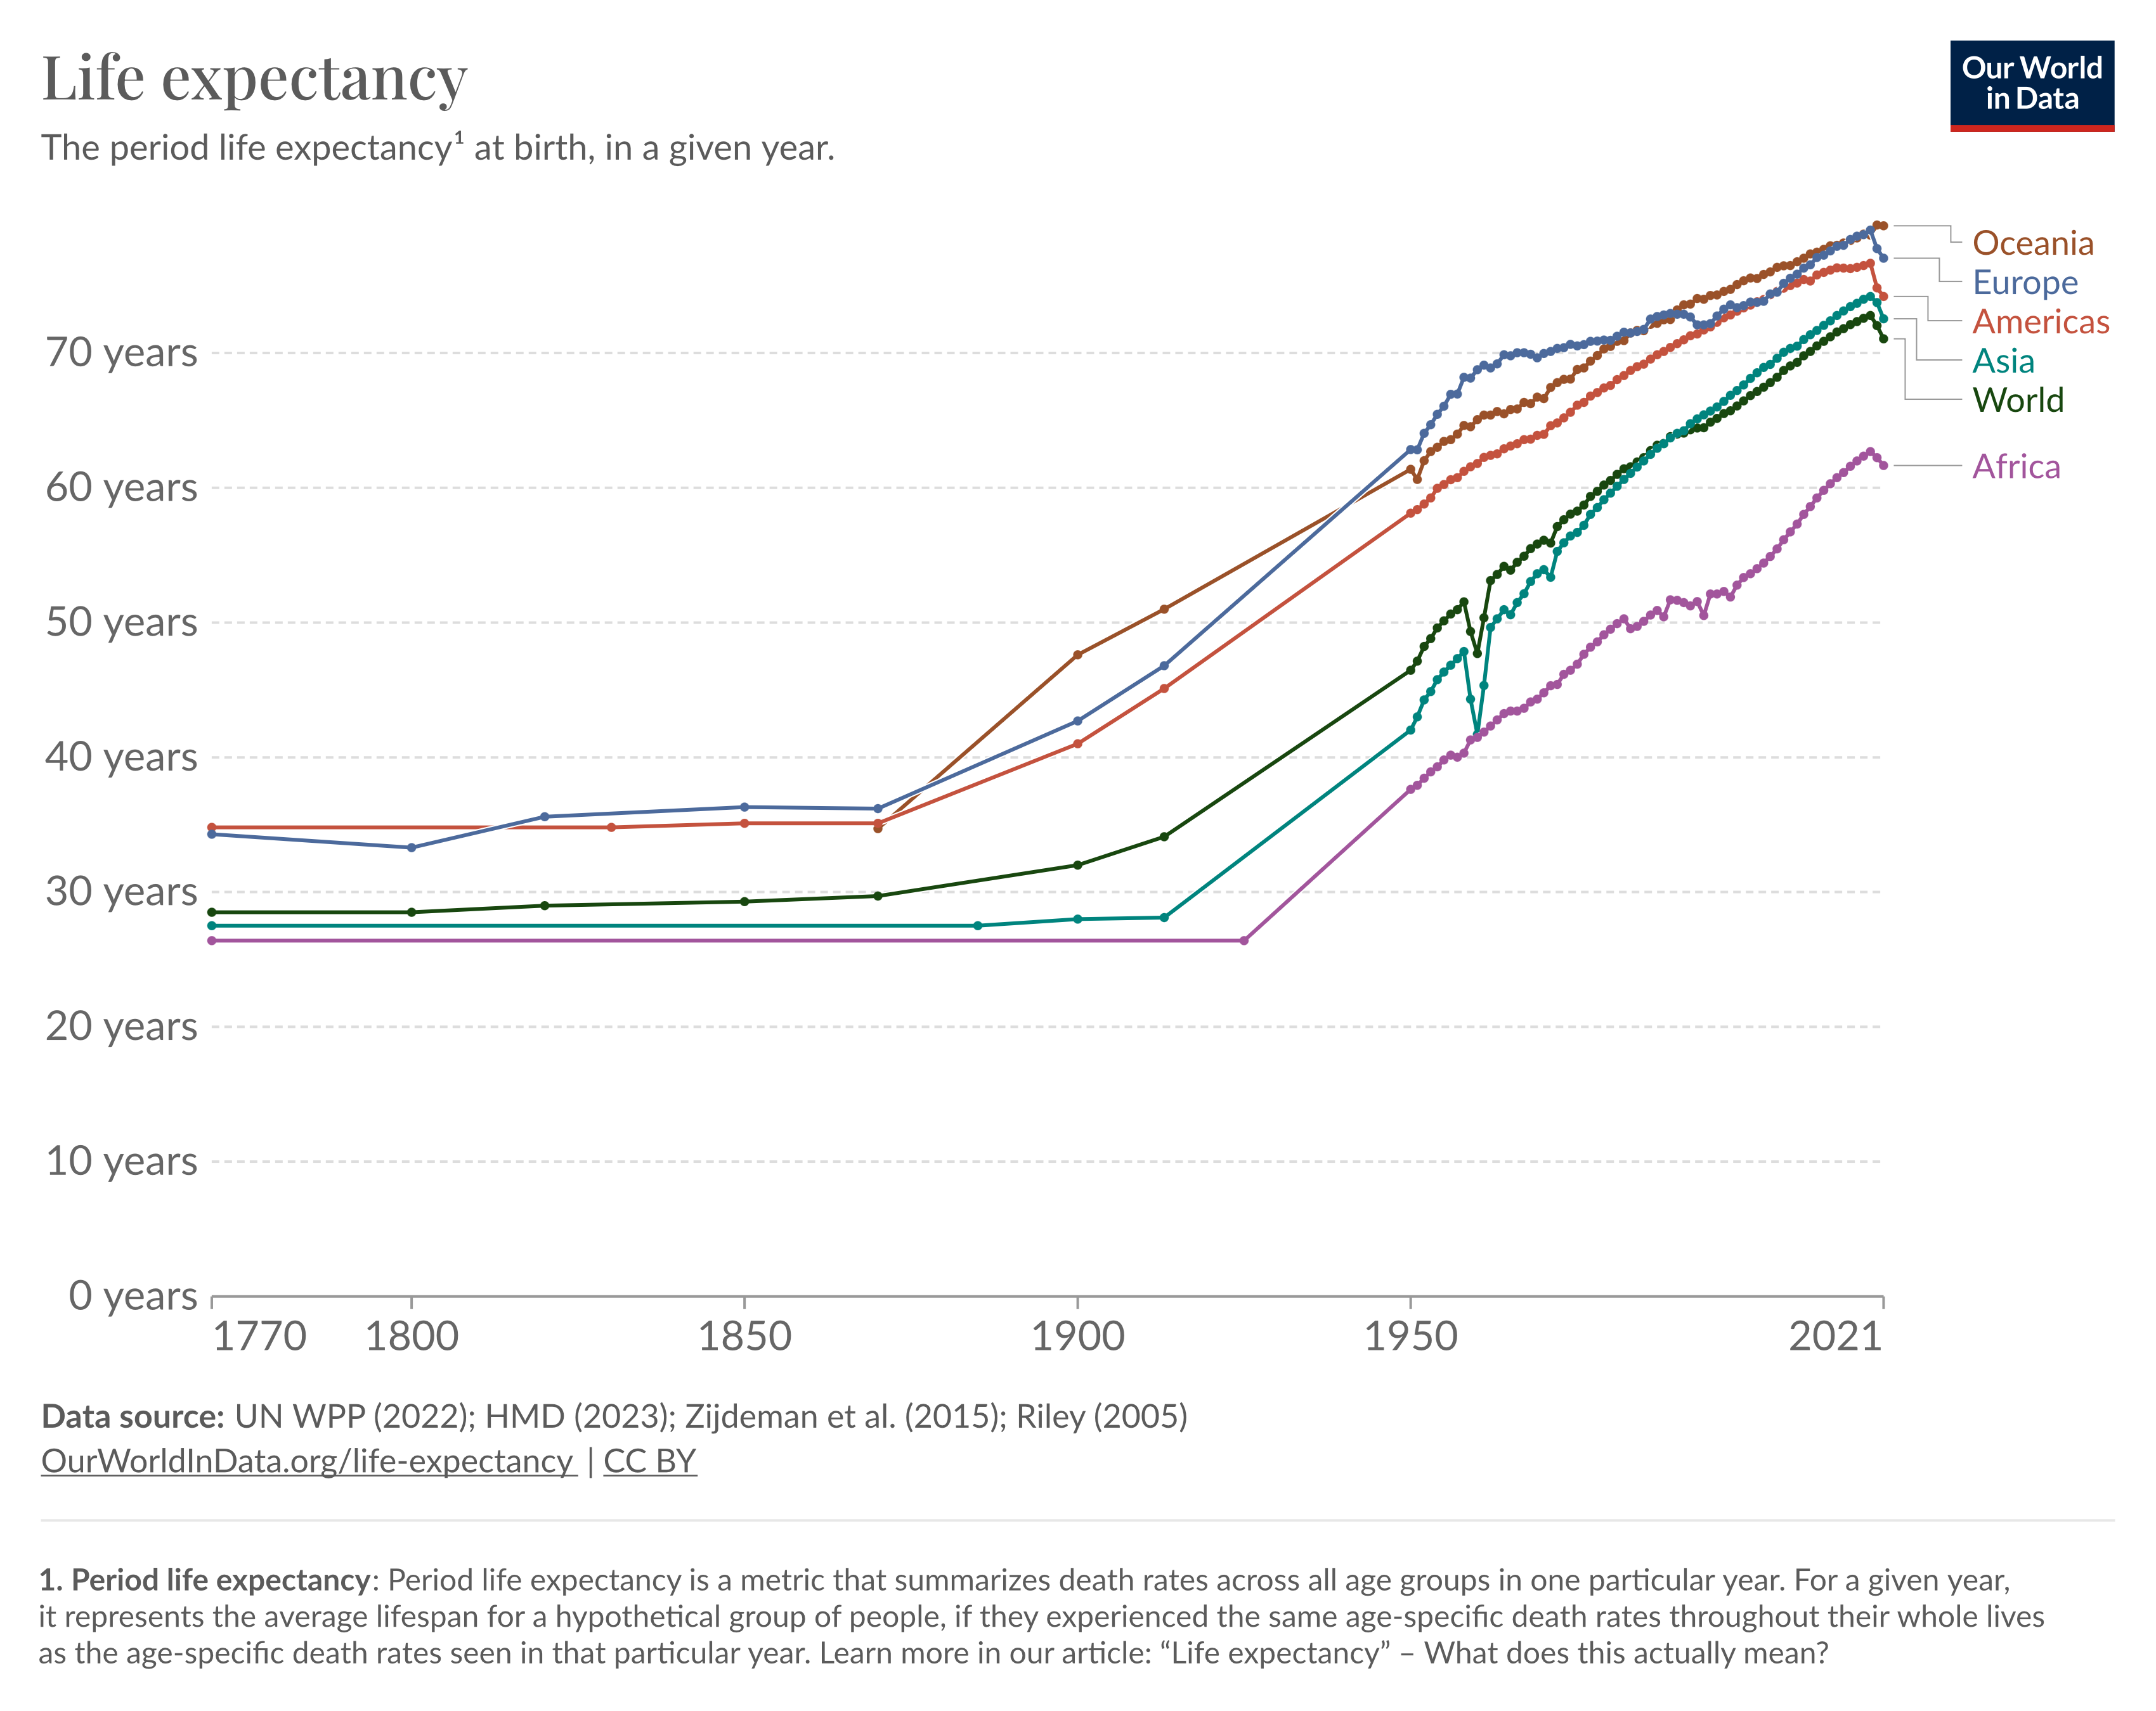

Slide 19
BIOS27815:
Infectious Diseases

Slide 20
The ‘Big Three’ (malaria, TB, and HIV) are the three top single infectious disease killers globally, accounting for >2.7 million annual deaths.
They disproportionately affect citizens of Low- and Middle-Income Countries (LMICs).
They receive the bulk of US and international global health funding, including through The Global Fund, a Geneva-based non-profit to fight HIV, TB, and malaria, with a ~$5 billion annual budget.

Slide 21
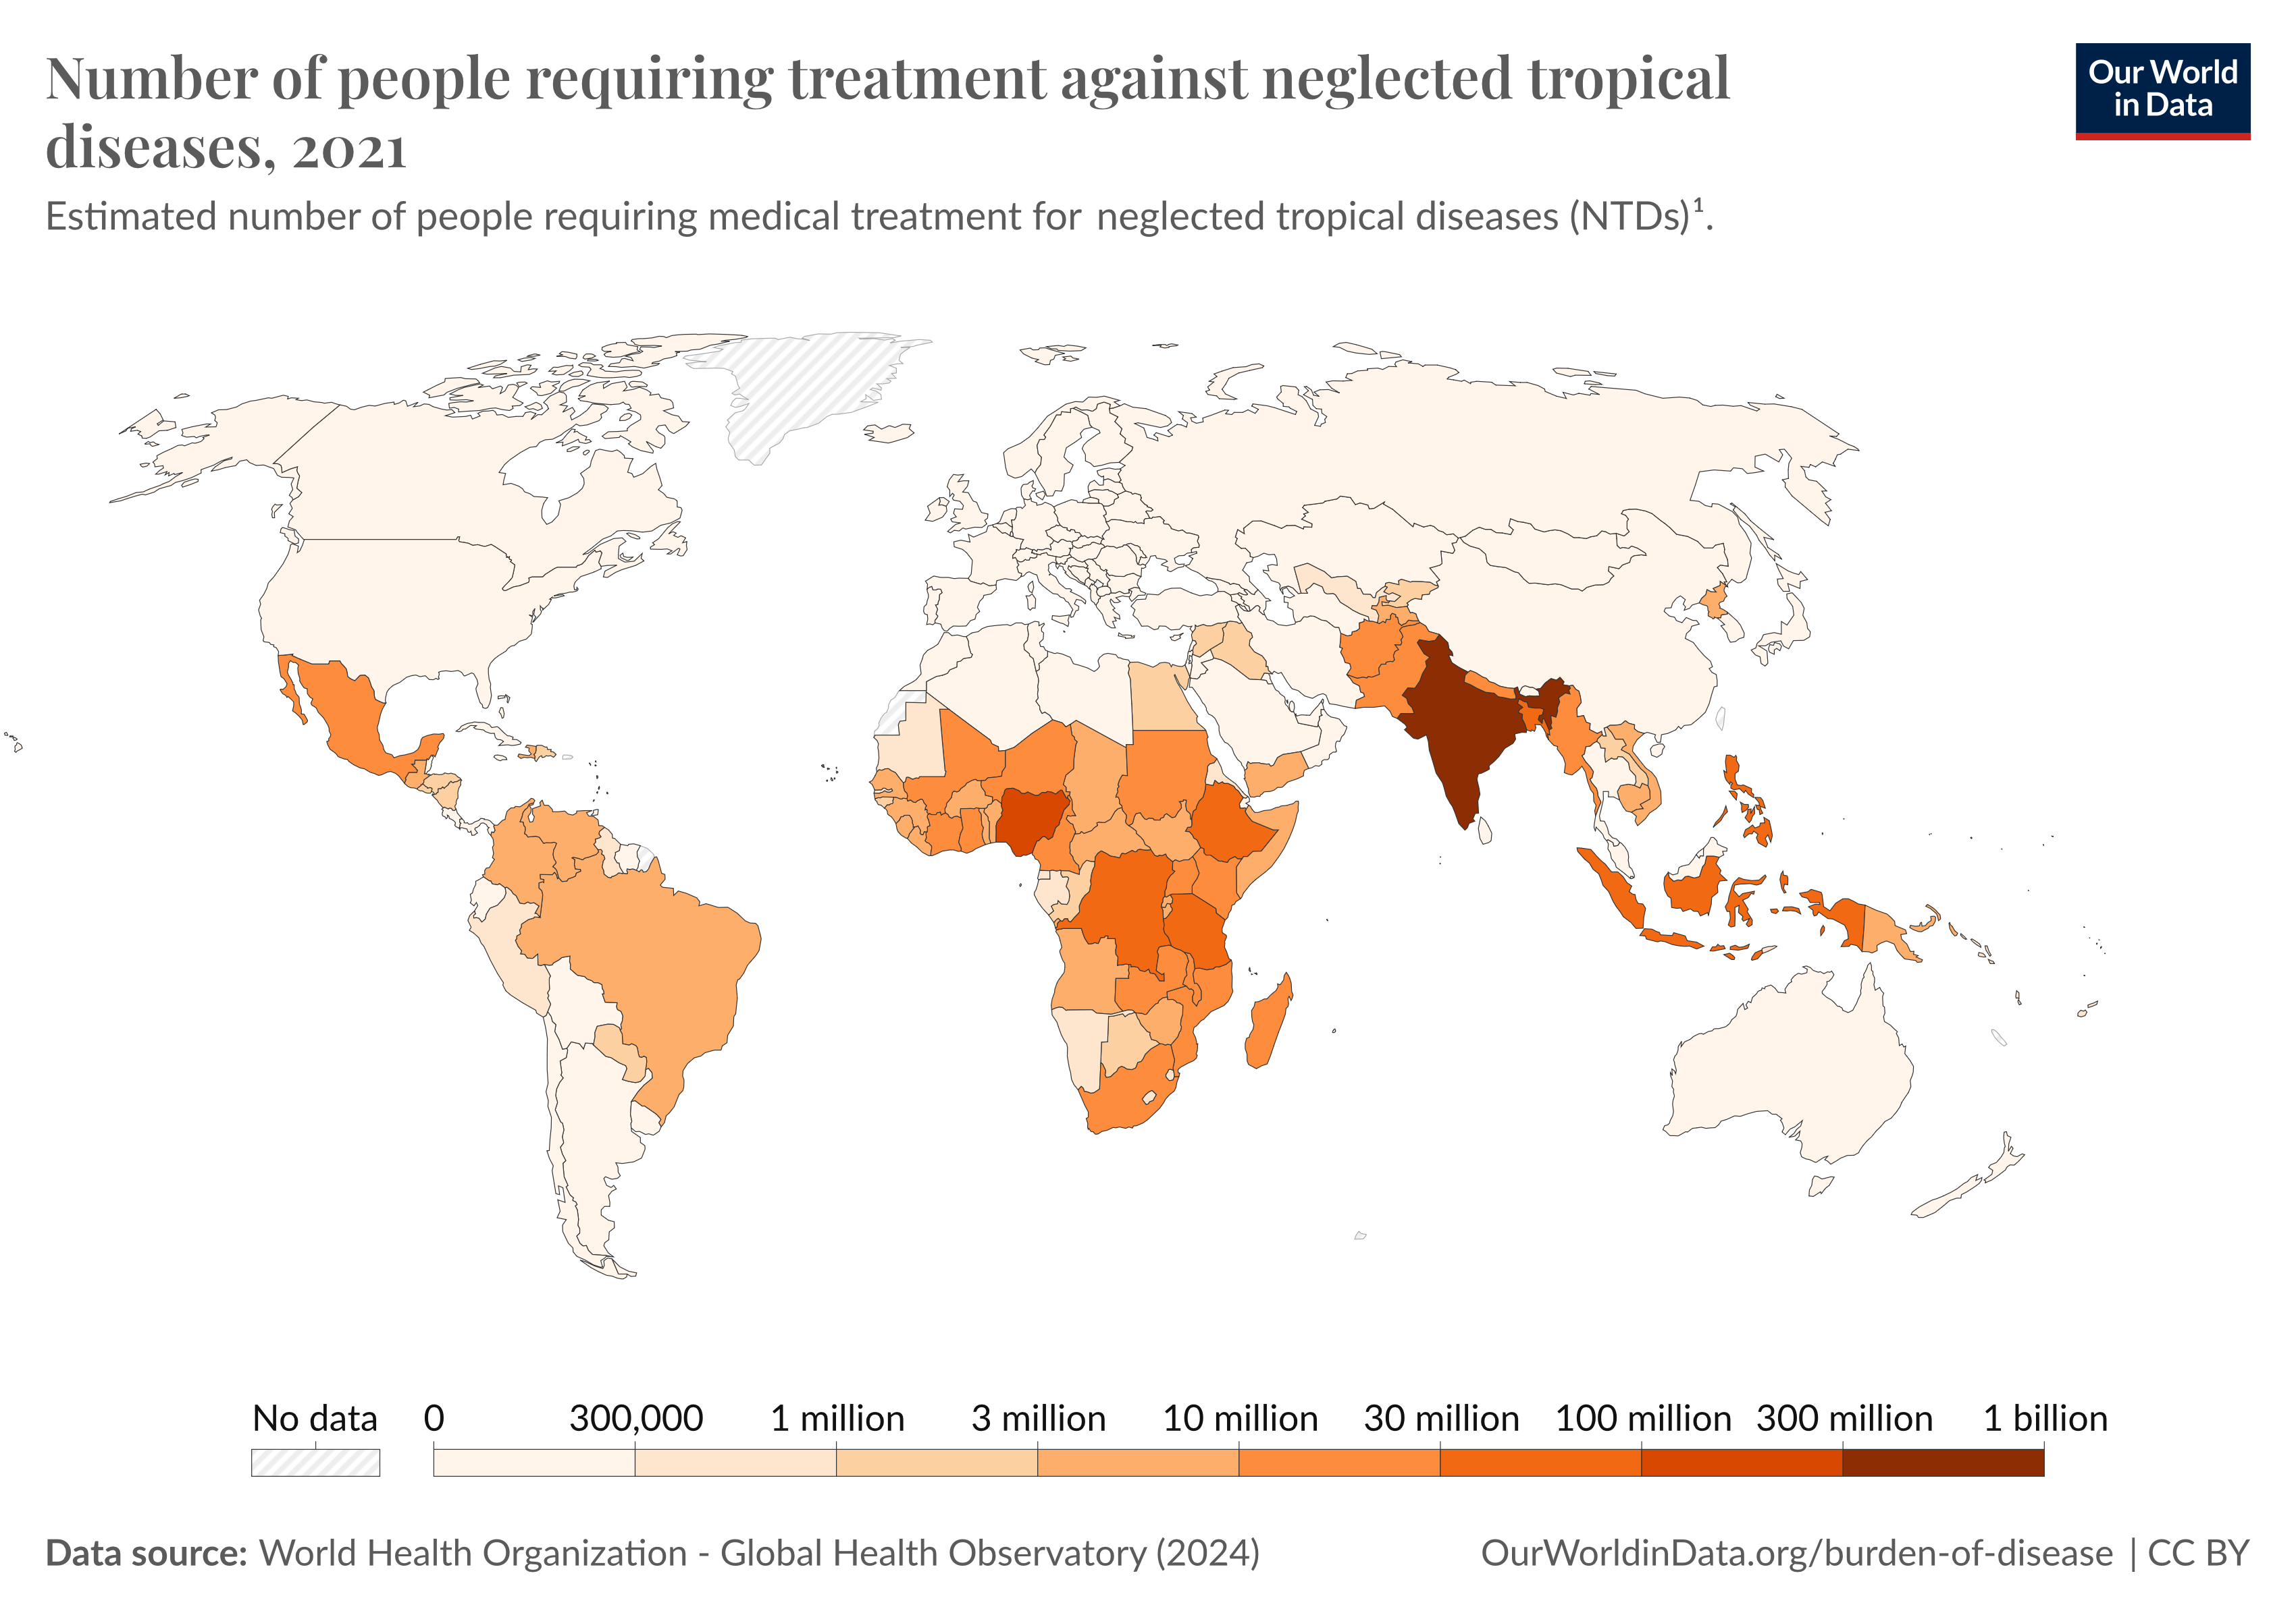
NTDs disproportionately affect citizens of Low- and Middle-Income Countries (LMICs).

Slide 22
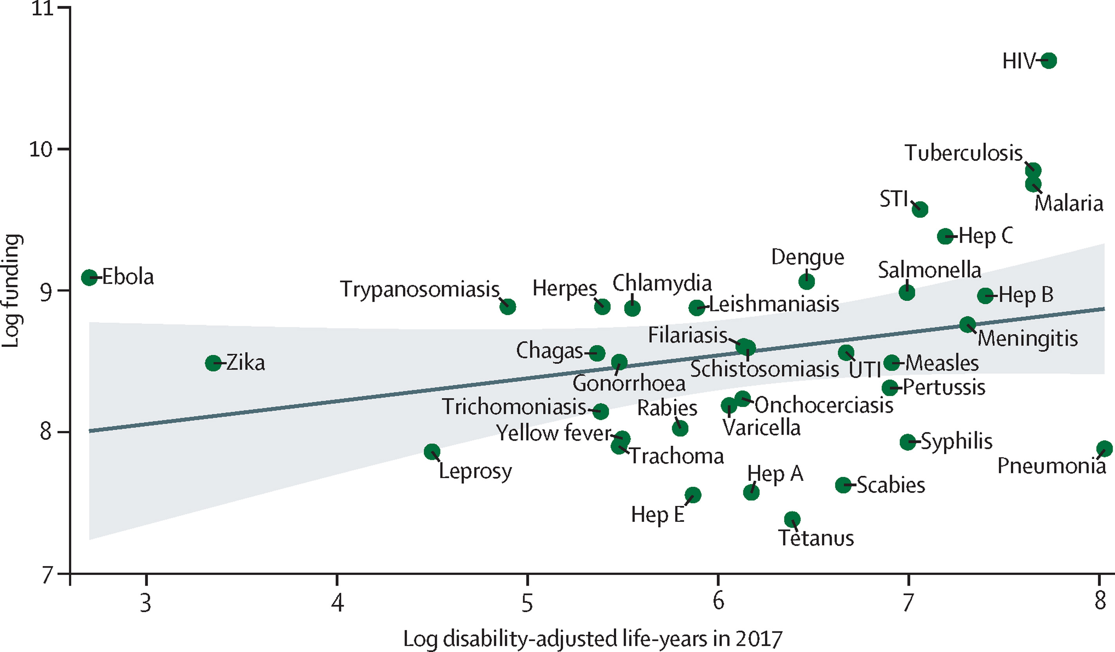
The funding dominance of the ‘Big Three’ means that many high burden infectious diseases are neglected every year.
1 DALY = the loss of the equivalent of one year of full health
Head et al. 2020. The Lancet.

Slide 23
Neglected Tropical Diseases (NTDs).
NTDs are diseases mainly prevalent among impoverished communities in tropical areas (though some have a larger geographical distribution) which are under-resourced as compared to the Big Three.
NTDs affect more than 1 billion people globally
WHO recognizes 21 NTDs:
Buruli ulcer
Chagas disease
dengue and chikungunya
Dracunculiasis
echinococcosis
foodborne trematodiases
human African trypanosomiasis
leishmaniasis
leprosy
lymphatic filariasis
mycetoma, chromoblastomycosis
noma
onchocerciasis
rabies
scabies, ectoparasitoses
schistosomiasis
soil-transmitted helminthiases
snakebite envenoming
taeniasis/cysticercosis
trachoma
yaws
Notes:
Dracunculiasis, also known as Guinea worm disease (GWD), is an infection caused by the parasite Dracunculus medinensis. GWD is a neglected tropical disease (NTD) transmitted to people mostly by consuming unsafe water.
Echinococcosis is a parasitic disease that occurs in two main forms in humans: cystic echinococcosis (also known as hydatidosis) and alveolar echinococcosis, caused by the tapeworms Echinococcus granulosus and Echinococcus multilocularis, respectively.
Foodborne trematodes are a group of diseases that include the parasites Clonorchis, Opisthorchis, Fasciola and Paragonimus. These parasitic flukes have a complex life cycle involving diverse definitive hosts and one or two intermediate hosts.
Mycetoma is a disease caused by certain types of bacteria and fungi found in soil, plant matter, and water. These bacteria and fungi may enter the body through a break in the skin, often on a person's foot. Mycetoma causes painless masses underneath the skin.
Noma is a severe gangrenous disease of the mouth and face. Its pathogenesis is linked with non-specific polymicrobial organisms and a range of modifiable risk factors and underlying social determinants shared with other neglected tropical diseases (NTDs).
Onchocerciasis is an eye and skin disease. Symptoms are caused by the microfilariae, which move around the human body in the subcutaneous tissue and induce intense inflammatory responses when they die. Infected people may show symptoms such as severe itching and various skin changes.
Snakebite envenoming is a potentially life-threatening disease caused by toxins in the bite of a venomous snake. Envenoming can also be caused by having venom sprayed into the eyes by certain species of snakes that have the ability to spit venom as a defence measure.
Taeniasis and cysticercosis are diseases of humans caused by a tapeworm (Taenia solium) that normally infects pigs. Taeniasis is an intestinal infection with the adult stage of the tapeworm. Cysticercosis is a tissue infection with the larval stage cysts of the tapeworm.
Trachoma is a disease of the eye caused by infection with the bacterium Chlamydia trachomatis.
Yaws is a chronic skin infection characterized by papillomas (noncancerous lumps) and ulcers. It is caused by the bacterium Treponema pallidum subspecies pertenue, which belongs to the same group of bacteria that causes venereal syphilis.

Slide 24
Goals for this lecture
To explain what we’re doing here
To introduce global health
To introduce infectious disease
To introduce methods for the study of infectious diseases

Slide 25
What causes disease? Perspectives through the ages
Four Humors: Hippocrates (c. 400 BC) wrote that disease results from an imbalance of the four humors
Notes:
Parasite isPathogen

Slide 26
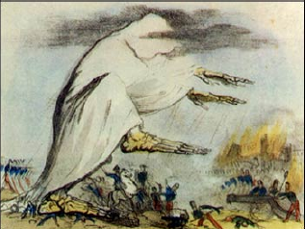
What causes disease? Perspectives through the ages
Four Humors: Hippocrates (c. 400 BC) wrote that disease results from an imbalance of the four humors
Miasmatic Theory: Extension of Hippocrates that lasted through the 1800s – idea that disease was caused by bad air. Popularized by Florence Nightengale
Notes:
Parasite isPathogen

Slide 27
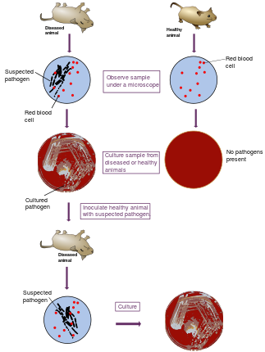
What causes disease? Perspectives through the ages
Four Humors: Hippocrates (c. 400 BC) wrote that disease results from an imbalance of the four humors
Miasmatic Theory: Extension of Hippocrates that lasted through the 1800s – idea that disease was caused by bad air.
Popularized by Florence Nightengale
Germ Theory of Disease: Idea that disease results from germs
Leuwenhoek’s microscope (1675)
Koch’s postulates (1890)
Notes:
Parasite isPathogen

Slide 28
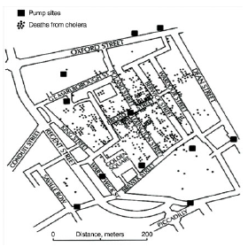
What causes disease? Perspectives through the ages
Four Humors: Hippocrates (c. 400 BC) wrote that disease results from an imbalance of the four humors
Miasmatic Theory: Extension of Hippocrates that lasted through the 1800s – idea that disease was caused by bad air.
Popularized by Florence Nightengale
Germ Theory of Disease: Idea that disease results from germs
Leuwenhoek’s microscope (1675)
Koch’s postulates (1890)
Classic epidemiology
Risk factors for disease = John Snow (1854)
Notes:
Parasite isPathogen

Slide 29
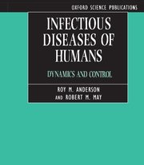
What causes disease? Perspectives through the ages
Four Humors: Hippocrates (c. 400 BC) wrote that disease results from an imbalance of the four humors
Miasmatic Theory: Extension of Hippocrates that lasted through the 1800s – idea that disease was caused by bad air.
Popularized by Florence Nightengale
Germ Theory of Disease: Idea that disease results from germs
Leuwenhoek’s microscope (1675)
Koch’s postulates (1890)
Classic epidemiology
Risk factors for disease = John Snow (1854)
Population biology of infectious disease
Understanding the process of infectious disease transmission. = Kermack and McKendrick (1927); Anderson and May (1991).
Notes:
Parasite isPathogen

Slide 30
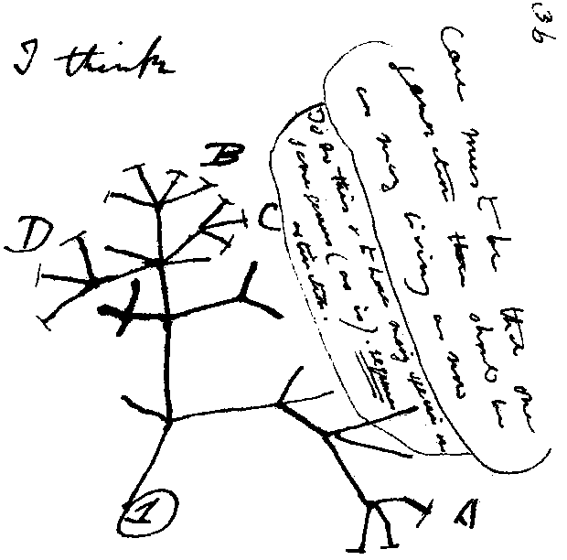
What is this?

Slide 31
What is this?
Charles Darwin’s notes –
world’s first phylogenetic tree !

Slide 32
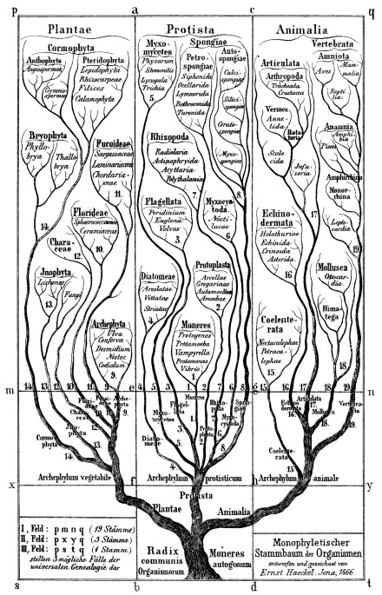
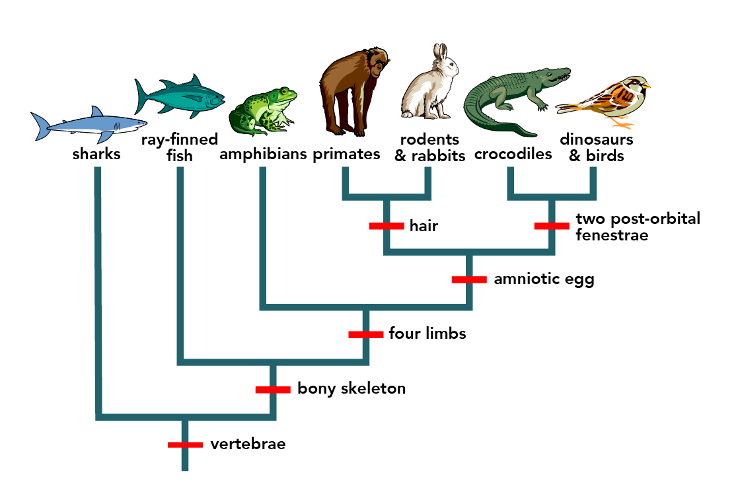
What is a phylogeny?
Baum et. al, Nature, 2008
Hossfeld and Levit, Nature, 2016

Slide 33
What is a phylogeny?
“A phylogenetic tree, or a phylogeny, is a diagram that depicts the lines of evolutionary descent of different species, organisms, or genes from a common ancestor.”
Baum et. al, Nature, 2008
Hossfeld and Levit, Nature, 2016

Slide 34
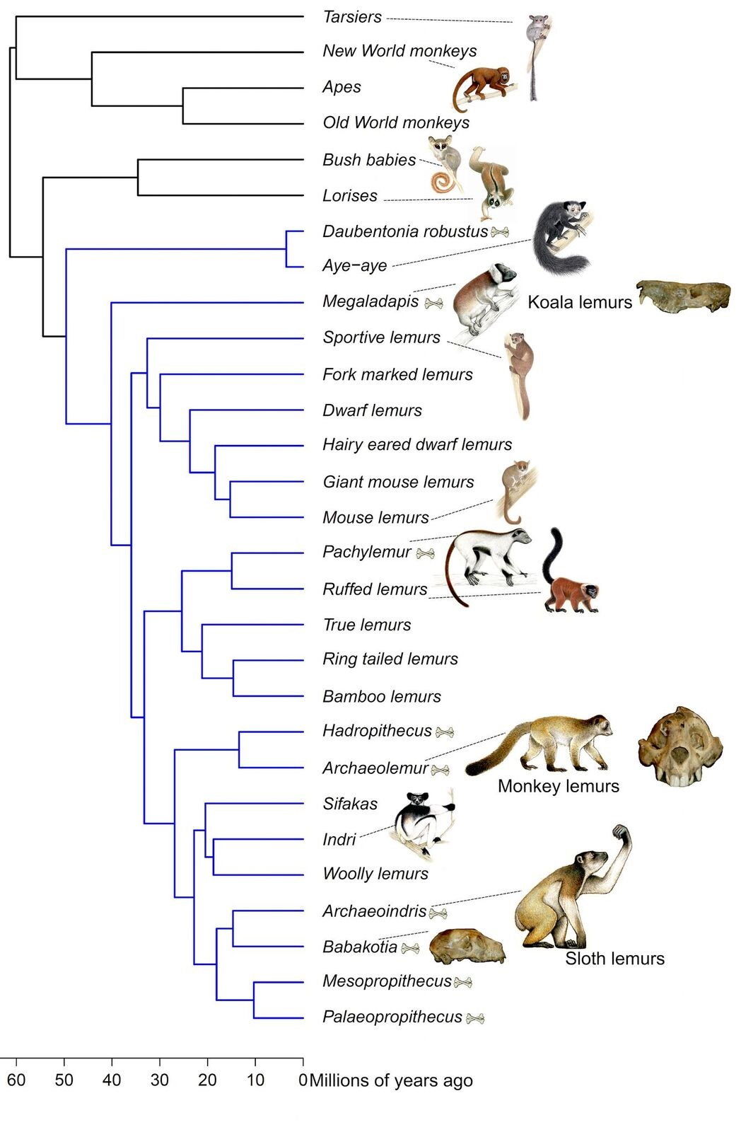
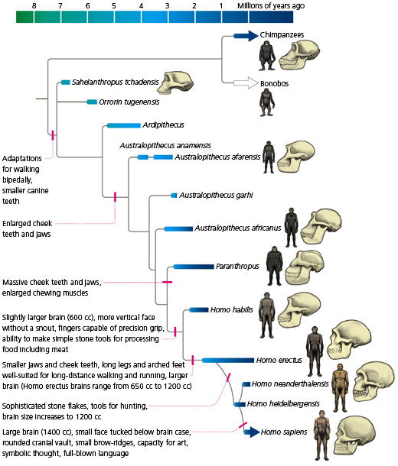
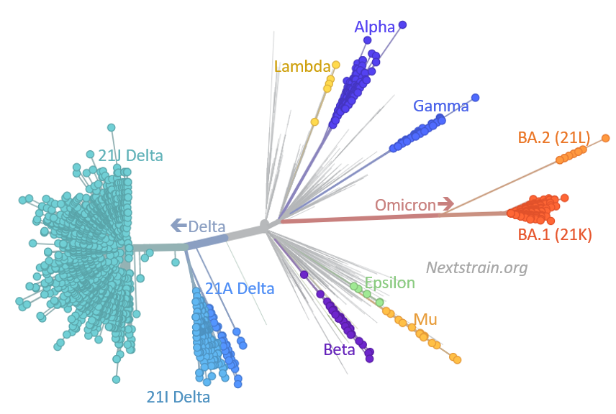
What can you do with phylogenies?
UC Museum of Paleontology
Herrera et al 2016
Lowe 2022

Slide 35
What can you do with phylogenies?
Origin of something, relatedness and differences
Diversification of species
Changes in real time
UC Museum of Paleontology
Herrera et al 2016
Lowe 2022

Slide 36
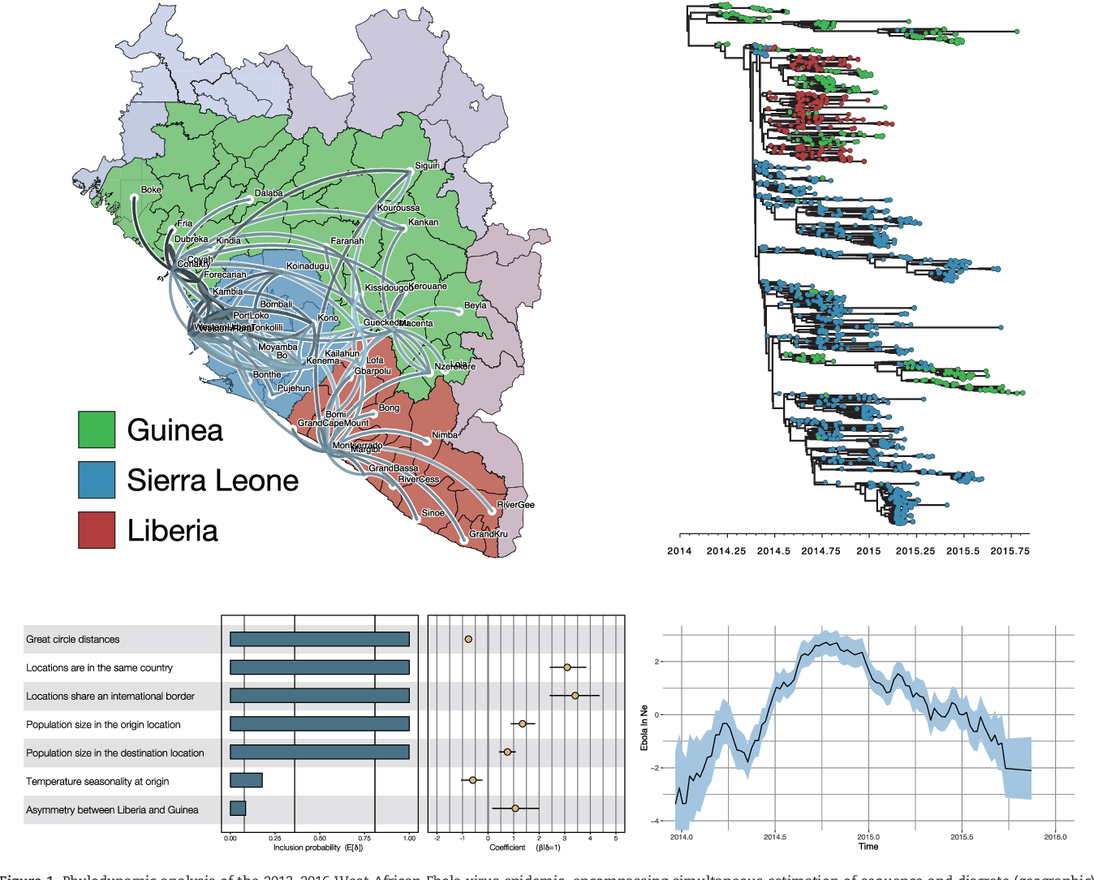
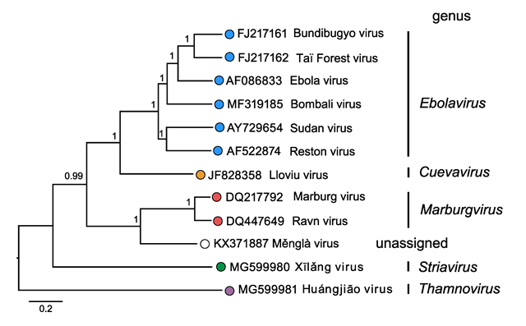
Phylodynamics
Bayesian trees
Maximum likelihood
WHEN is the most recent common ancestor?
HOW different is it to what’s known?
WHERE does it go?
Changes in real time
Suchard et al. 2018
Kuhn et al. 2019

Slide 37
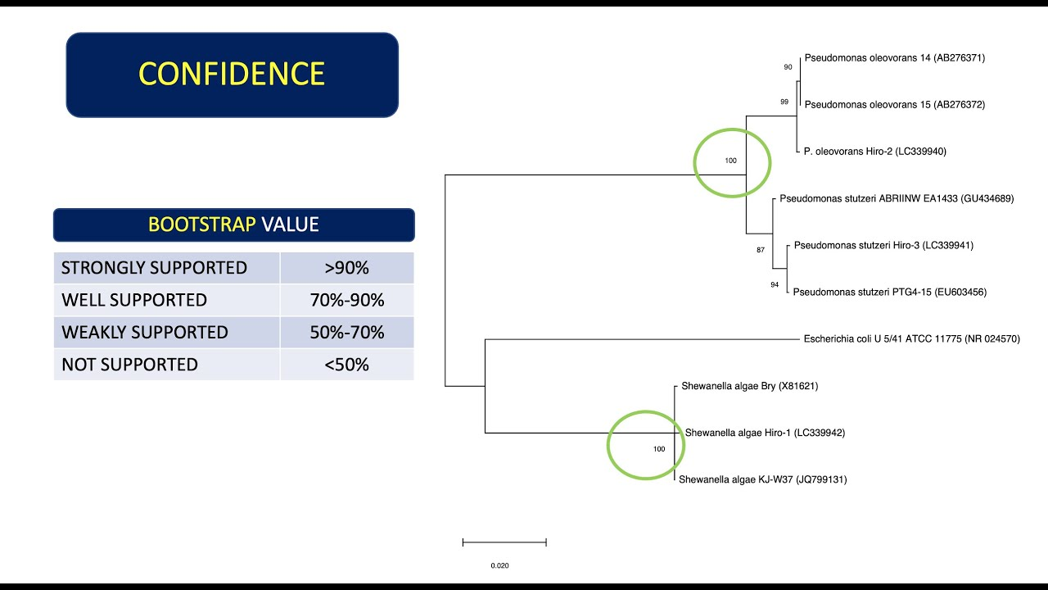
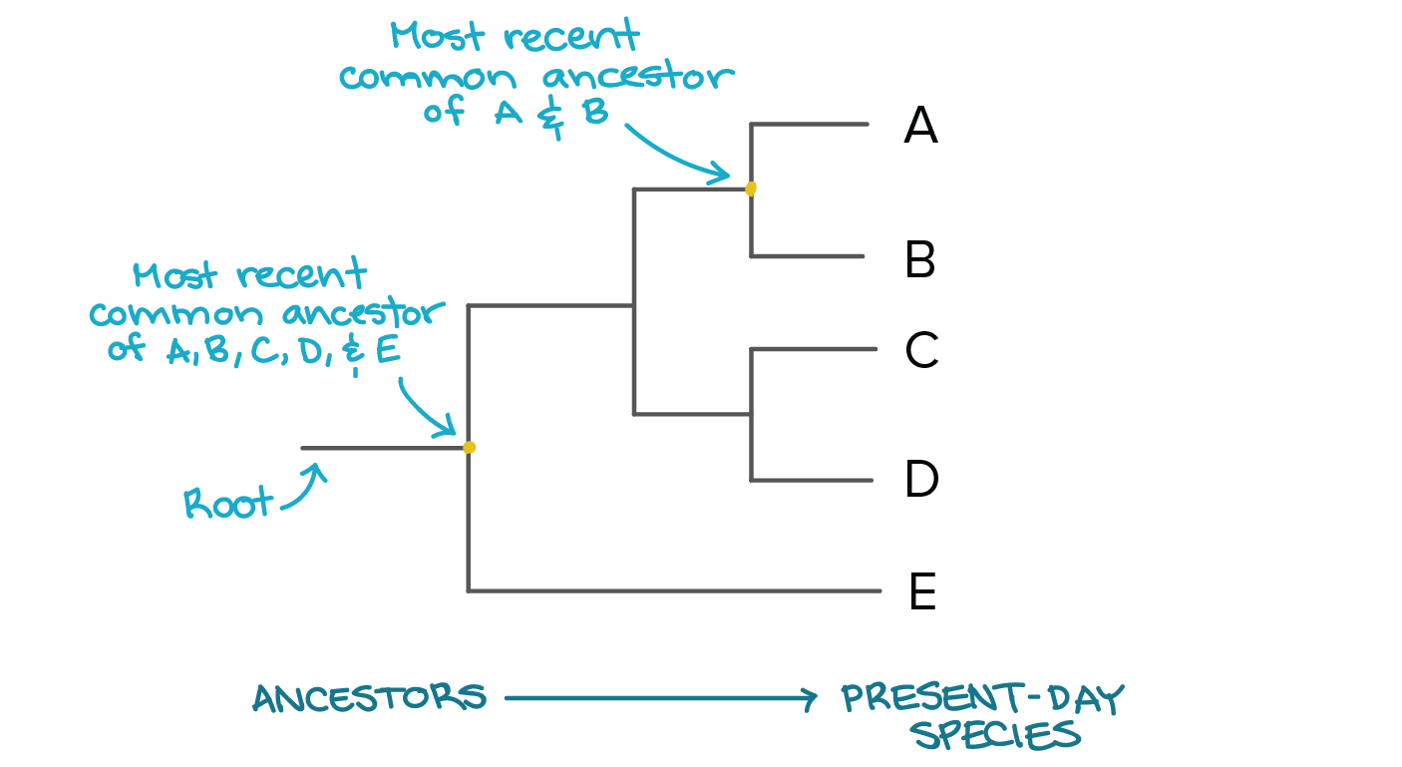
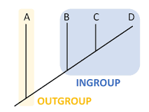
Anatomy of a phylogeny
Notes:
Root estimate is point at which outgroup joins the rest of the tree of interest
Bootstrapping gives you estimate of confidence of the branches in a phylogenetic tree

Slide 38
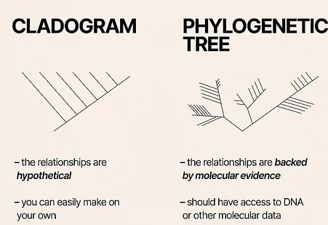

Slide 39
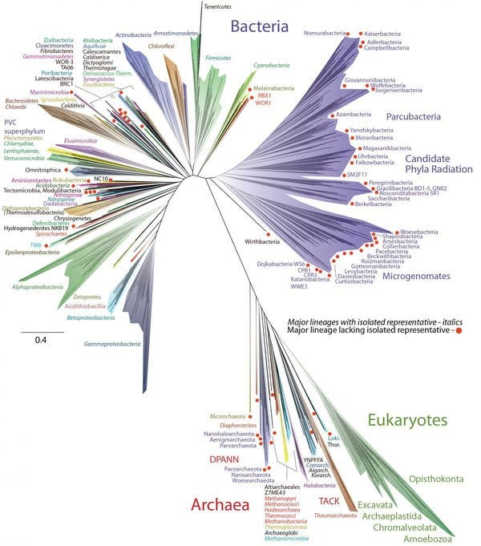
The parasite and pathogen tree of life
Notes:
Prokaryotes = bacteria and archaea; lack nucleus and other membrane-bound organelles
Eukaryotes = have a membrane bound nucleus

Slide 40
The parasite and pathogen tree of life
viruses???
Notes:
Viruses don’t fit in because no conserved structure, MRCA, also need to inhabit a host cell to survive. But they do have their own genetic material

Slide 41
Infectious diseases manifest from infection with a parasite or pathogen

Slide 42
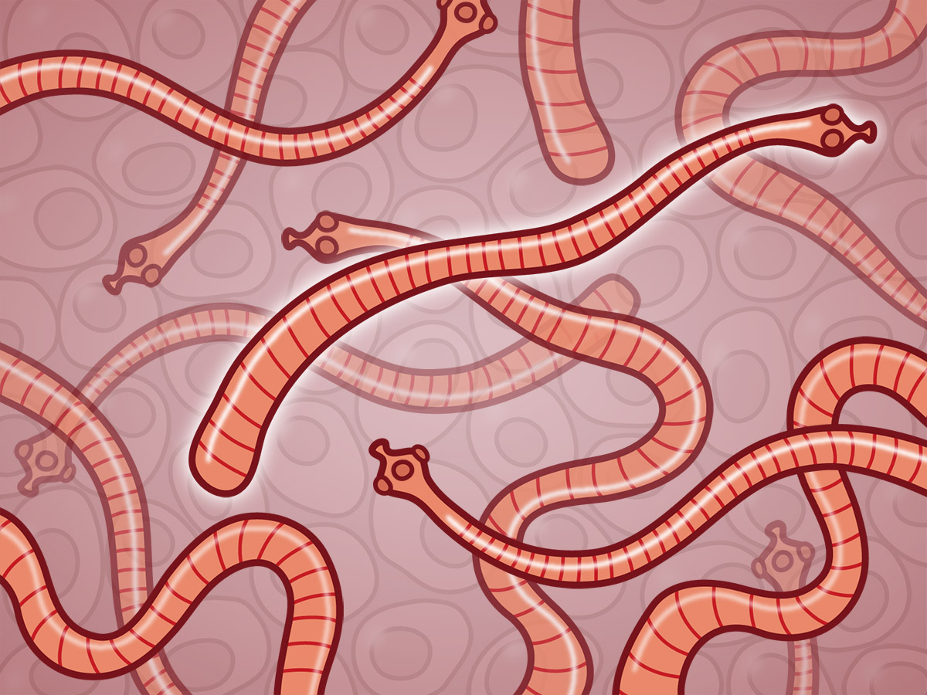
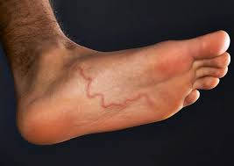
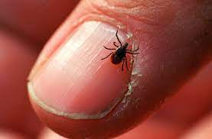
The parasite and pathogen tree of life
Parasite: an organism that lives in or on another organism and benefits at the expense of others (these are eukaryotes).
Ex: helminths (parasitic worms: tapeworms, roundworms, hookworms), ectoparasites (ticks, fleas)
Notes:
Parasite isPathogen

Slide 43
The parasite and pathogen tree of life
Parasite: an organism that lives in or on another organism and benefits at the expense of others (these are eukaryotes).
Ex: helminths (parasitic worms: tapeworms, roundworms, hookworms), ectoparasites (ticks, fleas)
Pathogen: a microorganism that can cause disease.
Ex: bacterium (prokaryote), virus, protozoan (eukaryote)
Notes:
Parasite isPathogen

Slide 44
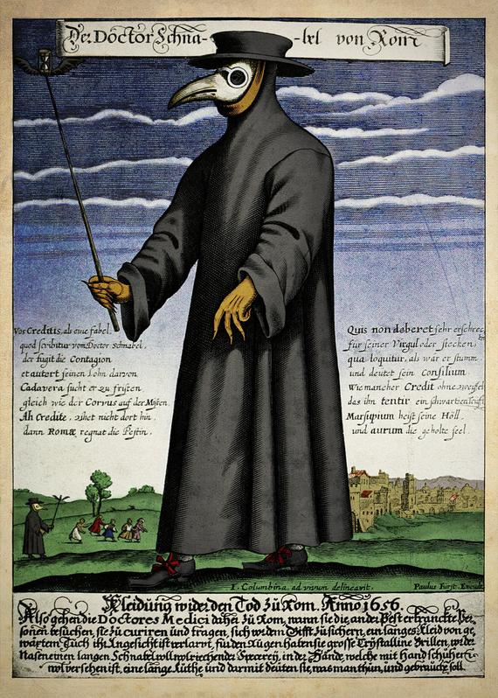
The parasite and pathogen tree of life
Parasite: an organism that lives in or on another organism and benefits at the expense of others (these are eukaryotes).
Ex: helminths (parasitic worms: tapeworms, roundworms, hookworms), ectoparasites (ticks, fleas)
Pathogen: a microorganism that can cause disease.
Ex: bacterium (prokaryote), virus, protozoan (eukaryote)
Pathogen: Yersinia pestis
Disease: Plague
Notes:
Parasite isPathogen

Slide 45
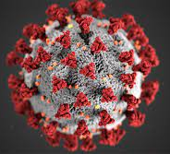
The parasite and pathogen tree of life
Parasite: an organism that lives in or on another organism and benefits at the expense of others (these are eukaryotes).
Ex: helminths (parasitic worms: tapeworms, roundworms, hookworms), ectoparasites (ticks, fleas)
Pathogen: a microorganism that can cause disease.
Ex: bacterium (prokaryote), virus, protozoan (eukaryote)
Pathogen: Yersinia pestis
Disease: Plague
Pathogen: SARS-CoV-2
Disease: COVID-19
Notes:
Parasite isPathogen

Slide 46
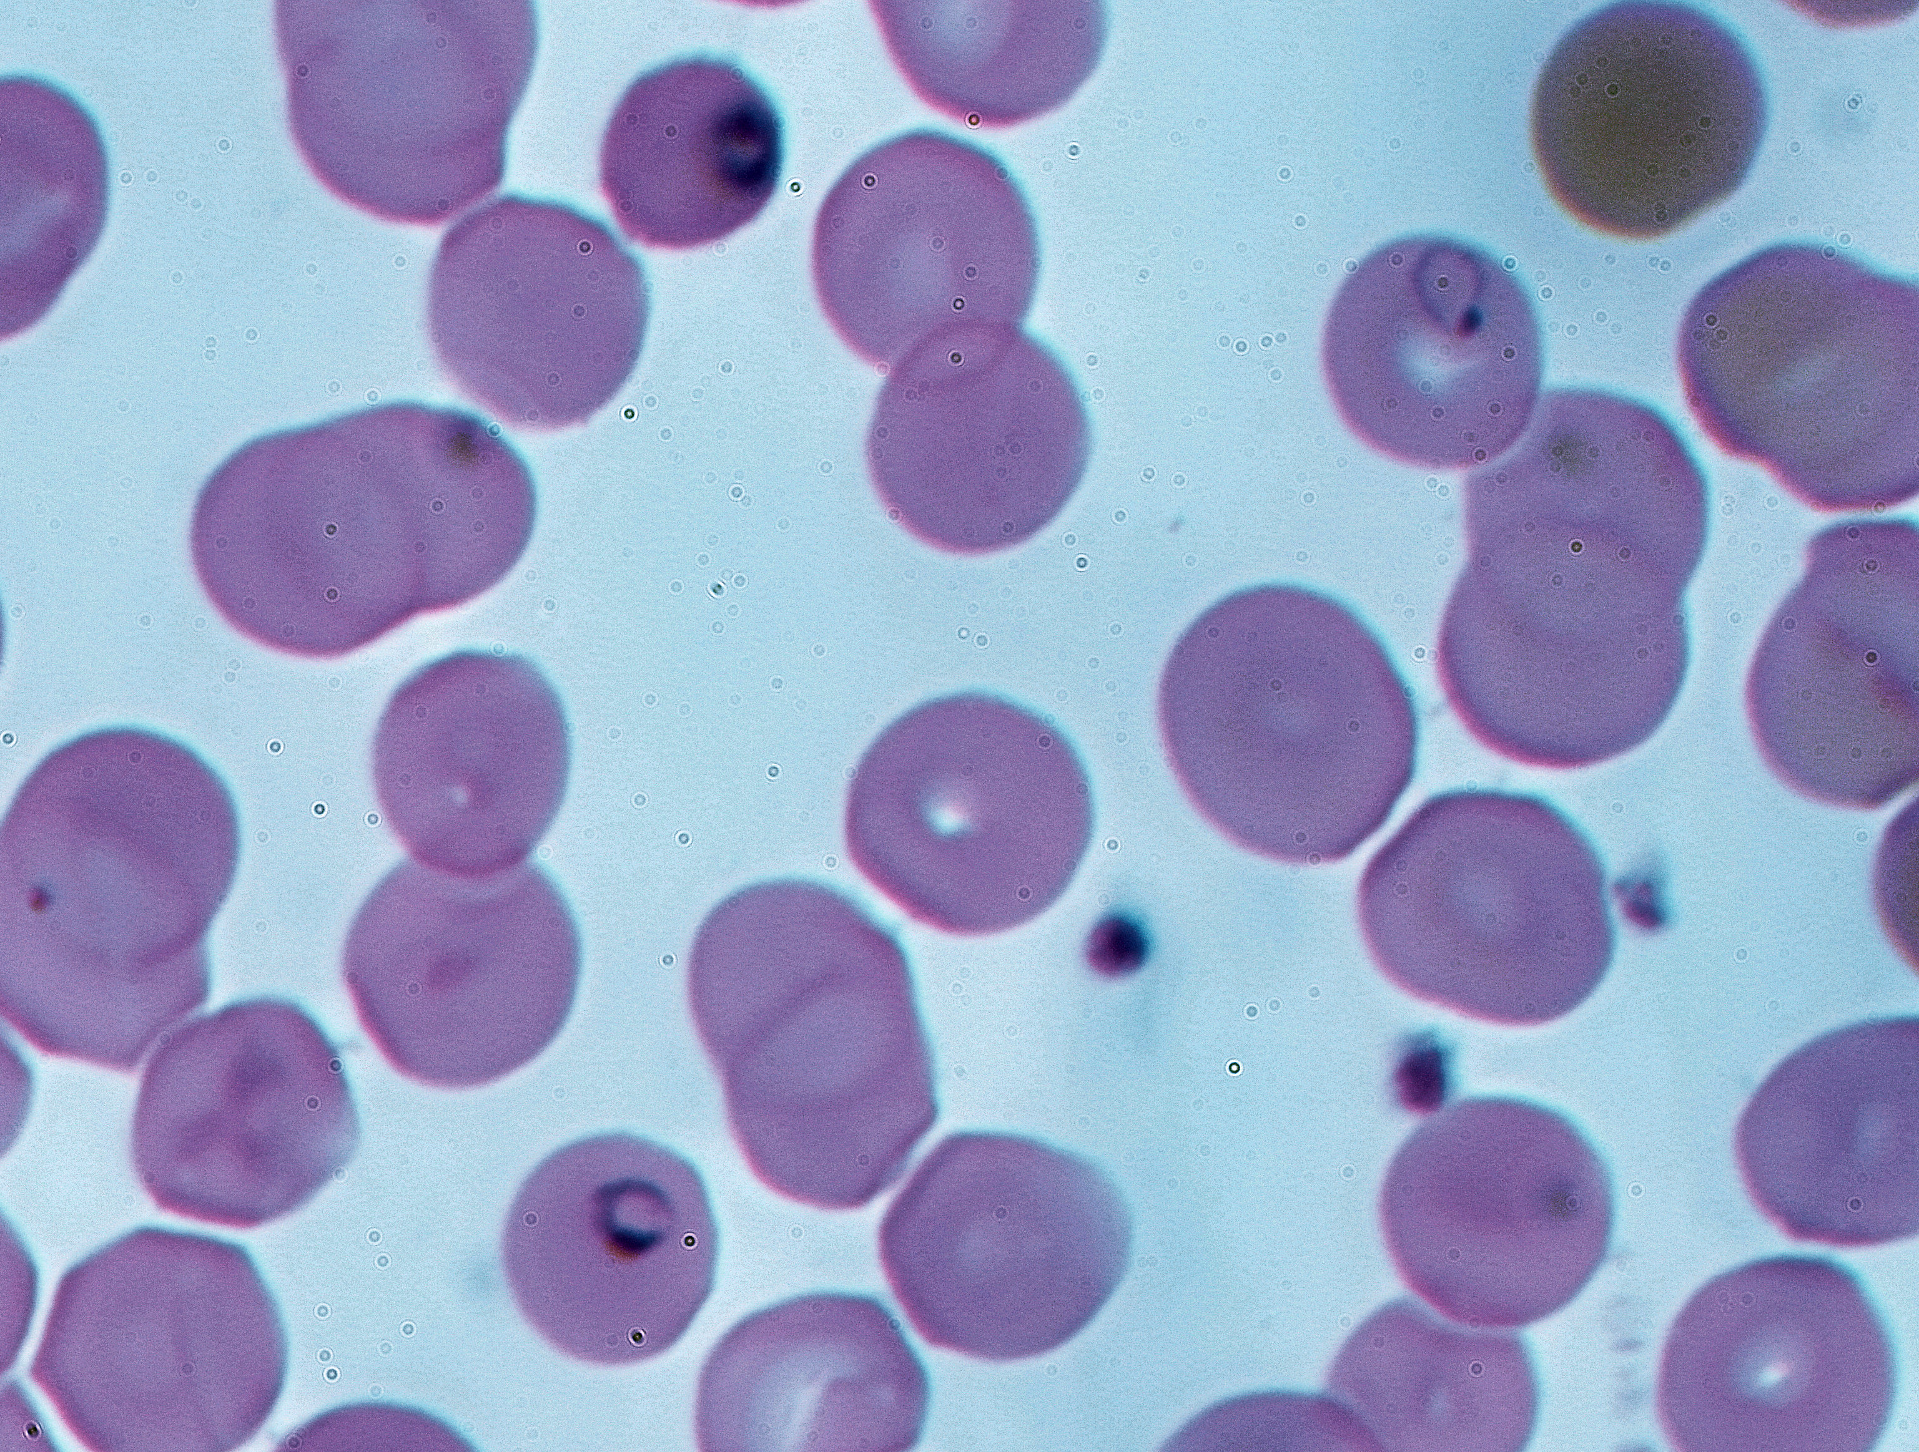
The parasite and pathogen tree of life
Parasite: an organism that lives in or on another organism and benefits at the expense of others (these are eukaryotes).
Ex: helminths (parasitic worms: tapeworms, roundworms, hookworms), ectoparasites (ticks, fleas)
Pathogen: a microorganism that can cause disease.
Ex: bacterium (prokaryote), virus, protozoan (eukaryote)
Pathogen: Yersinia pestis
Disease: Plague
Pathogen: Plasmodium falciparum, P. vivax, P. malariae, P. ovale, P. knowlesi
Disease: malaria
Pathogen: SARS-CoV-2
Disease: COVID-19
Notes:
Parasite isPathogen

Slide 47
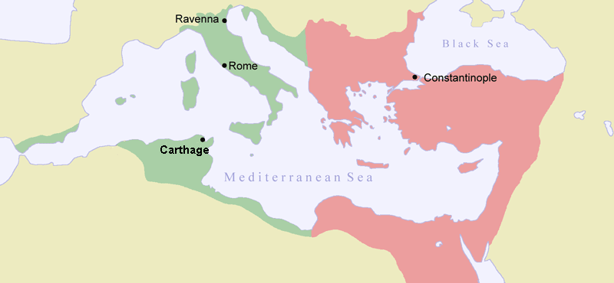
Parasites and pathogens have shaped human history.
Plague of Justinian (541-549 AD)
First historically recorded pandemic of Yersinia pestis
Launched the ‘first plague pandemic’ resulting in the deaths of 15-100 million people, 25-60% of Europe’s population at the time
Notes:
Parasite is an organism that lives in or on another organism and benefits at the expense of others.
Pathogen

Slide 48
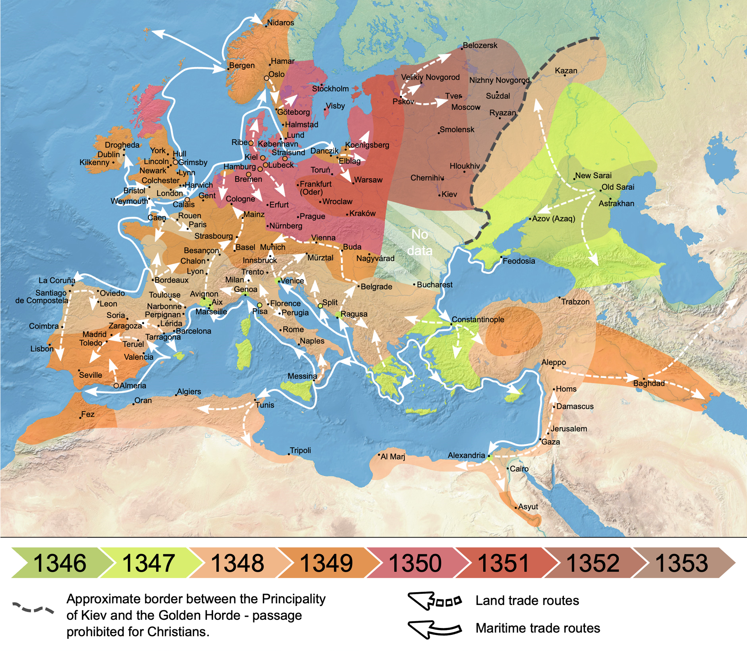
Parasites and pathogens have shaped human history.
Plague of Justinian (541-549 AD)
Black Death (1346-1353 AD)
Most fatal pandemic in human history, resulting in deaths of 75-200 million people
Killed 30-60% of Europe’s population at the time; 17-54% of global population
Notes:
By Flappiefh - Own work from:Natural Earth ;The origin and early spread of the Black Death in Italy: first evidence of plague victims from 14th-century Liguria (northern Italy) maps by O.J. Benedictow., CC BY-SA 4.0, https://commons.wikimedia.org/w/index.php?curid=66468361

Slide 49
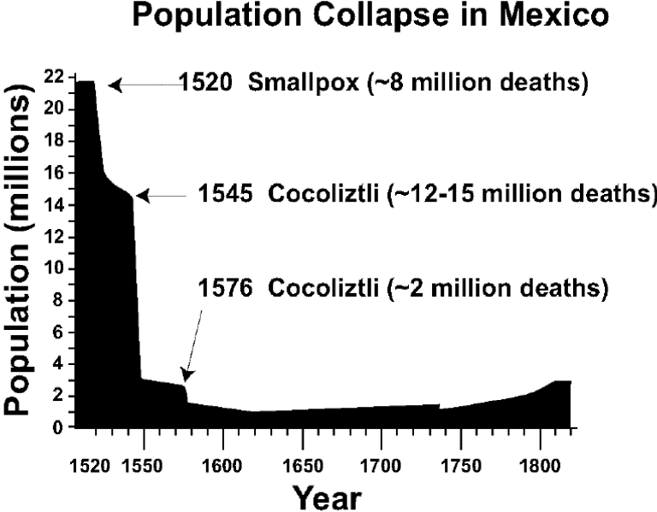
Parasites and pathogens have shaped human history.
Plague of Justinian (541-549 AD)
Black Death (1346-1353 AD)
Cocoliztli (1545-1548)
Pathogen still unknown! Maybe viral hemorrhagic fever, maybe bacterium
Killed 80% of the population of Mexico
Notes:
By Flappiefh - Own work from:Natural Earth ;The origin and early spread of the Black Death in Italy: first evidence of plague victims from 14th-century Liguria (northern Italy) maps by O.J. Benedictow., CC BY-SA 4.0, https://commons.wikimedia.org/w/index.php?curid=66468361

Slide 50
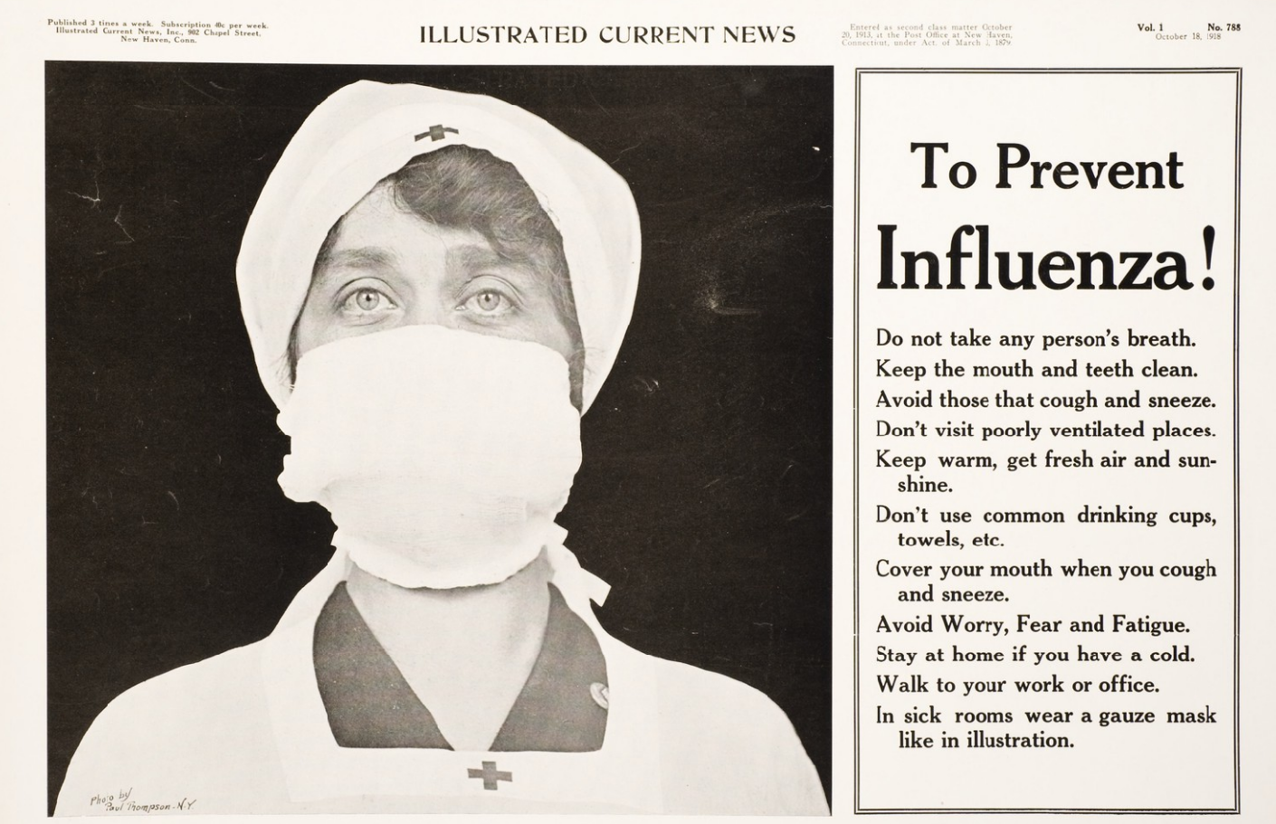
Parasites and pathogens have shaped human history.
Plague of Justinian (541-549 AD)
Black Death (1346-1353 AD)
Cocoliztli (1545-1548)
Spanish Influenza (1918-1920)
17-100 million deaths worldwide.
1-5% of global population
2nd-most devastating pandemic in history (after Black Death)
Notes:
The pandemic broke out near the end of World War I, when wartime censors in the belligerent countries suppressed bad news to maintain morale, but newspapers freely reported the outbreak in neutral Spain, creating a false impression of Spain as the epicenter and leading to the "Spanish flu" misnomer.[

Slide 51
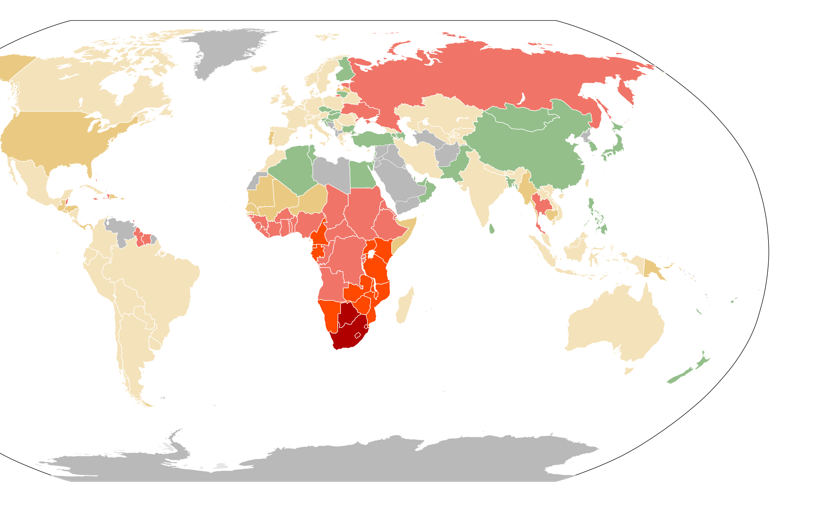
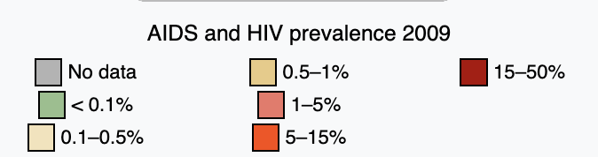
Parasites and pathogens have shaped human history.
Plague of Justinian (541-549 AD)
Black Death (1346-1353 AD)
Cocoliztli (1545-1548)
Spanish Influenza (1918-1920)
HIV (~1960-now)
>40 million deaths and counting
Prevalence still >20% in some countries in southern Africa

Slide 52
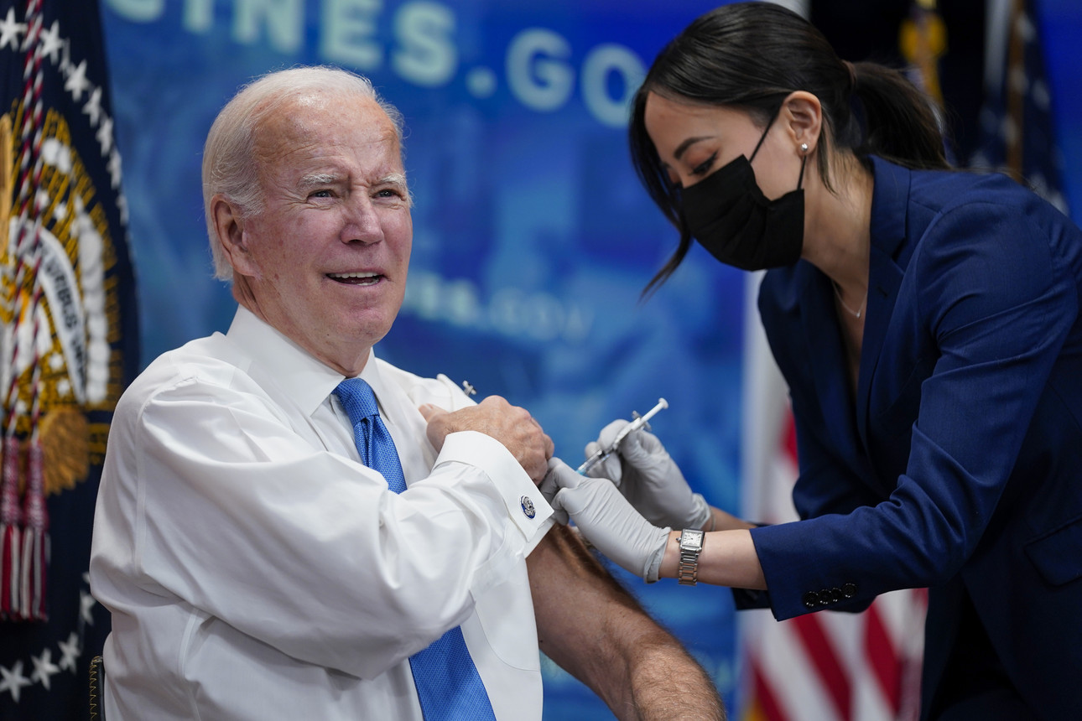
Parasites and pathogens have shaped human history.
Plague of Justinian (541-549 AD)
Black Death (1346-1353 AD)
Cocoliztli (1545-1548)
Spanish Influenza (1918-1920)
HIV (~1960-now)
COVID-19 (2019-now)
~7-30 million deaths worldwide and counting
~0.1-0.4% of population
Notes:
According to a UNAIDS dataset sourced from the World Bank, in 2019 the HIV prevalence rate for adults aged 15 to 49 was 27% in Eswatini (Swaziland), 25% in Lesotho, 25% in Botswana and 19% in South Africa.^{[1]}

Slide 53
Parasites and pathogens have also shaped human DNA.
Notes:
The way in which sickle cell protects against malaria is attributed to several different things. One of the more common explanations is that the sickle hemoglobin inhibits the plasmodium parasite from infecting the red blood cells which reduces the number of malaria parasites to infect the host. Another factor is the production of heme oxygenase-1 (HO-1) enzyme, which is highly present in the sickle hemoglobin. This enzyme produces carbon monoxide which has been proven to protect against cerebral malaria
Normally, a person inherits two copies of the gene that produces beta-globin, a protein needed to produce normal hemoglobin (hemoglobin A, genotype AA). A person with sickle cell trait inherits one normal allele and one abnormal allele encoding hemoglobin S (hemoglobin genotype AS)
The sickle cell trait can be used to demonstrate the concepts of co-dominance and incomplete dominance. An individual with the sickle cell trait shows incomplete dominance when the shape of the red blood cell is considered. This is because the sickling happens only at low oxygen concentrations. With regards to the actual concentration of hemoglobin in the circulating cells, the alleles demonstrate co-dominance as both 'normal' and mutant forms co-exist in the bloodstream. Thus it is an ambiguous condition showing both incomplete dominance and co-dominance
2021, there were an estimated 247 million cases of malaria worldwide.
The estimated number of malaria deaths stood at 619 000 in 2021.
The WHO African Region carries a disproportionately high share of the global malaria burden. In 2021, the region was home to 95% of malaria cases and 96% of malaria deaths. Children under 5 accounted for about 80% of all malaria deaths in the Region.

Slide 54
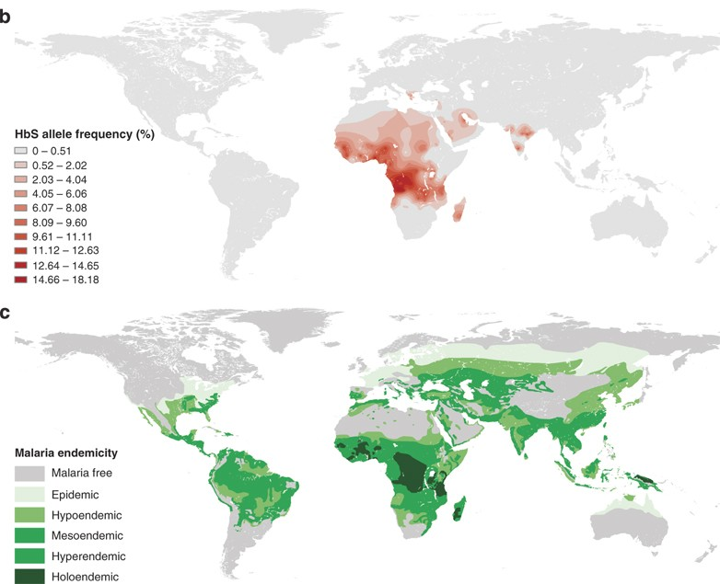
Parasites and pathogens have also shaped human DNA.
Sickle cell anemia
The HbS allele confers resistance to malaria but also results in sickle cell anemia when homozygous.
Natural selection has favored this trait in malaria-endemic regions of the planet.
As of 2021, WHO estimates 247 million malaria cases worldwide and >600,000 deaths, 95% in Africa.
Children <5 account for 80% of malaria deaths.
Piel et al 2010. Nature Communications.
Notes:
The way in which sickle cell protects against malaria is attributed to several different things. One of the more common explanations is that the sickle hemoglobin inhibits the plasmodium parasite from infecting the red blood cells which reduces the number of malaria parasites to infect the host. Another factor is the production of heme oxygenase-1 (HO-1) enzyme, which is highly present in the sickle hemoglobin. This enzyme produces carbon monoxide which has been proven to protect against cerebral malaria
Normally, a person inherits two copies of the gene that produces beta-globin, a protein needed to produce normal hemoglobin (hemoglobin A, genotype AA). A person with sickle cell trait inherits one normal allele and one abnormal allele encoding hemoglobin S (hemoglobin genotype AS)
The sickle cell trait can be used to demonstrate the concepts of co-dominance and incomplete dominance. An individual with the sickle cell trait shows incomplete dominance when the shape of the red blood cell is considered. This is because the sickling happens only at low oxygen concentrations. With regards to the actual concentration of hemoglobin in the circulating cells, the alleles demonstrate co-dominance as both 'normal' and mutant forms co-exist in the bloodstream. Thus it is an ambiguous condition showing both incomplete dominance and co-dominance
2021, there were an estimated 247 million cases of malaria worldwide.
The estimated number of malaria deaths stood at 619 000 in 2021.
The WHO African Region carries a disproportionately high share of the global malaria burden. In 2021, the region was home to 95% of malaria cases and 96% of malaria deaths. Children under 5 accounted for about 80% of all malaria deaths in the Region.

Slide 55
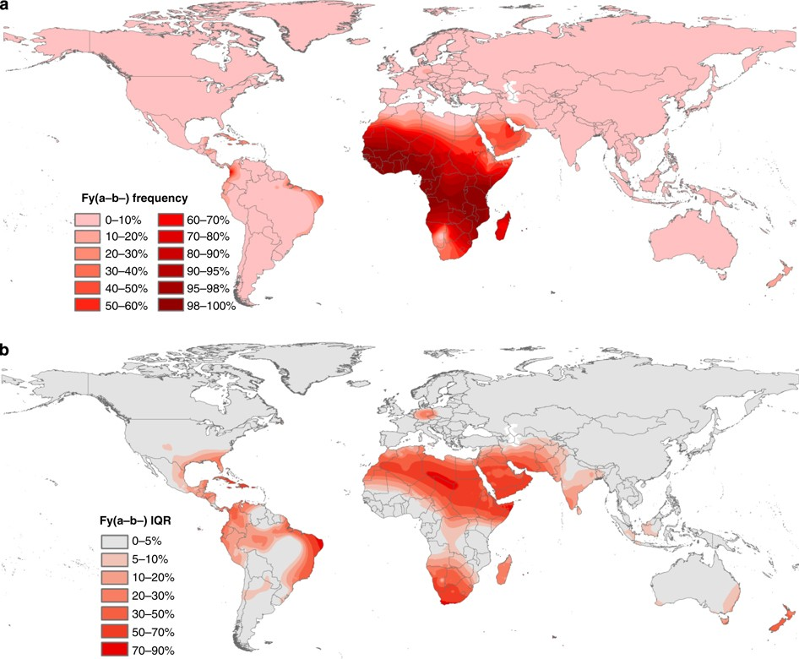
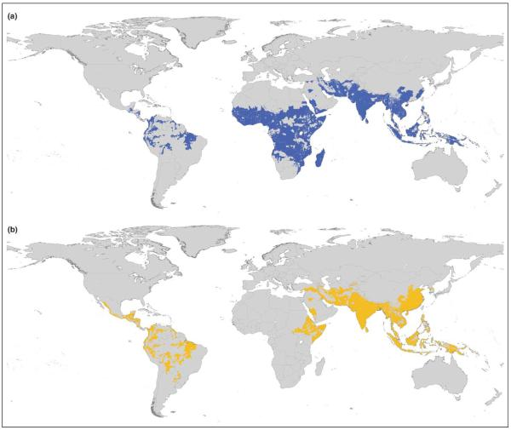
Parasites and pathogens have also shaped human DNA.
Duffy antigen
Modeled distribution of Duffy-negative human population
Distribution Plasmodium falciparum
Distribution Plasmodium vivax
Guerra et al. 2006. Trends in Parasitology
Howes et al 2011. Nature Communications.

Slide 56
Goals for this lecture
To explain what we’re doing here
To introduce global health
To introduce infectious disease
To introduce methods for the study of infectious diseases

Slide 57
Epidemiology vs. Population Biology (Disease Dynamics)
Epidemiology = “the study of what is on the people”
Coined by Spanish physician Villalba in 1802
Emphasis on the study and analysis of the distribution and determinants of health and disease (“risk factors”)
Including chronic diseases!
Often uses cross-sectional data to demonstrate associations of variables with outcome (disease)
More statistical (y=mx+b)
Pattern
Disease Ecology = the study of how a disease spreads
Emphasis on the interactions of organisms with each other and the environment…when interactions result in disease
Emphasis on understanding the transmission dynamics of infectious disease
Typically involves fitting dynamical (population) models to time series data
More mathematical (dN/dt)
Process

Slide 58
Epidemiology vs. Population Biology (Disease Dynamics)
Epidemiology = “the study of what is on the people”
Coined by Spanish physician Villalba in 1802
Emphasis on the study and analysis of the distribution and determinants of health and disease (“risk factors”)
Including chronic diseases!
Often uses cross-sectional data to demonstrate associations of variables with outcome (disease)
More statistical (y=mx+b)
Pattern
Population biology/Disease ecology = the study of how a disease spreads
Emphasis on the interactions of organisms with each other and the environment…when interactions result in disease
Emphasis on understanding the transmission dynamics of infectious disease
Typically involves fitting dynamical (population) models to time series data
More mathematical (dN/dt)
Process

Slide 59
Epidemiology vs. Population Biology (Disease Dynamics)
Epidemiology = “the study of what is on the people”
Coined by Spanish physician Villalba in 1802
Emphasis on the study and analysis of the distribution and determinants of health and disease (“risk factors”)
Including chronic diseases!
Often uses cross-sectional data to demonstrate associations of variables with outcome (disease)
More statistical (y=mx+b)
Pattern
Population biology = the study of how a disease spreads
Emphasis on the interactions of organisms with each other and the environment…when interactions result in disease
Emphasis on understanding the transmission dynamics of infectious disease
Typically involves fitting dynamical (population) models to time series data
More mathematical (dN/dt)
Process

Slide 60
Epidemiology vs. Population Biology (Disease Dynamics)
Epidemiology = “the study of what is on the people”
Coined by Spanish physician Villalba in 1802
Emphasis on the study and analysis of the distribution and determinants of health and disease (“risk factors”)
Including chronic diseases!
Often uses cross-sectional data to demonstrate associations of variables with outcome (disease)
More statistical (y=mx+b)
Pattern
Population biology = the study of how a disease spreads
Emphasis on the interactions of organisms with each other and the environment…when interactions result in disease
Emphasis on understanding the transmission dynamics of infectious disease
Typically involves fitting dynamical (population) models to time series data
More mathematical (dN/dt)
Process

Slide 61
Epidemiology vs. Population Biology (Disease Dynamics)
Epidemiology = “the study of what is on the people”
Coined by Spanish physician Villalba in 1802
Emphasis on the study and analysis of the distribution and determinants of health and disease (“risk factors”)
Including chronic diseases!
Often uses cross-sectional data to demonstrate associations of variables with outcome (disease)
More statistical (y=mx+b)
Pattern
Population biology = the study of how a disease spreads
Emphasis on the interactions of organisms with each other and the environment…when interactions result in disease
Emphasis on understanding the transmission dynamics of infectious disease
Typically involves fitting dynamical (population) models to time series data
More mathematical (dN/dt)
Process

Slide 62
Some important epidemiological terminology
R0, Reff, force of infection, herd immunity, critical vaccination threshold
Review dynamical fever

Slide 63
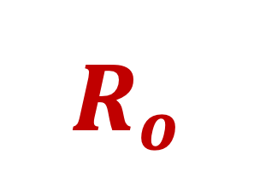
$$R_{o}$$
The basic reproduction number for a pathogen

Slide 64
$$R_{o}$$
The basic reproduction number for a pathogen
Defined as: the number of new cases caused by one infectious case in a completely susceptible population

Slide 65
$$R_{o}$$
The basic reproduction number for a pathogen
Defined as: the number of new cases caused by one infectious case in a completely susceptible population

Slide 66
$$R_{o}$$
The basic reproduction number for a pathogen
Defined as: the number of new cases caused by one infectious case in a completely susceptible population

Slide 67
$$R_{o}$$
The basic reproduction number for a pathogen
Defined as: the number of new cases caused by one infectious case in a completely susceptible population

Slide 68
$$R_{o}$$
The basic reproduction number for a pathogen
Defined as: the number of new cases caused by one infectious case in a completely susceptible population

Slide 69
$$R_{o}$$
The basic reproduction number for a pathogen
Defined as: the number of new cases caused by one infectious case in a completely susceptible population

Slide 70
$$R_{o}$$
The basic reproduction number for a pathogen
Defined as: the number of new cases caused by one infectious case in a completely susceptible population

Slide 71

$$R_{o}$$
The basic reproduction number for a pathogen
Defined as: the number of new cases caused by one infectious case in a completely susceptible population
What is $R_{o}$?

Slide 72
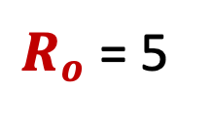
$$R_{o}$$
The basic reproduction number for a pathogen
Defined as: the number of new cases caused by one infectious case in a completely susceptible population
What is $R_{o}$?
$R_{o}$ = 5

Slide 73
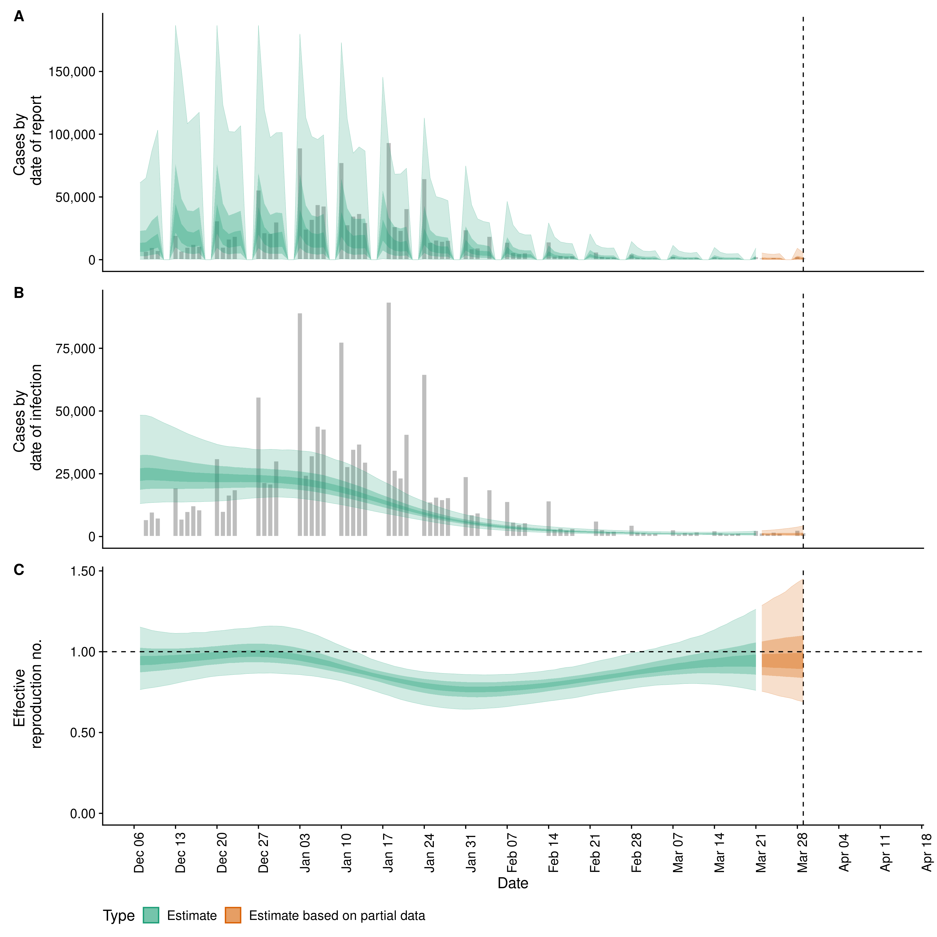
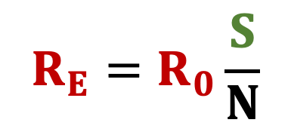
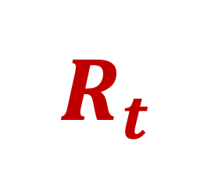

$$R_{E}$$
$$R_{t}$$
COVID projections for Illinois through March 2022
OR
The effective reproduction number for a pathogen
Defined as: the number of new cases caused by one infectious case in a partially susceptible population
Calculated as R0*proportion susceptible
$$R_{E}=R_{0}\frac{S}{N}$$
Gives a realistic pulse of the current pace of the epidemic!
epiforecasts.io

Slide 74
$$R_{E}$$
$$R_{t}$$
COVID projections for Illinois through March 2022
OR
The effective reproduction number for a pathogen
Defined as: the number of new cases caused by one infectious case in a partially susceptible population
Calculated as R0*proportion susceptible
$$R_{E}=R_{0}\frac{S}{N}$$
Gives a realistic pulse of the current pace of the epidemic!
epiforecasts.io

Slide 75
$$R_{E}$$
$$R_{t}$$
COVID projections for Illinois through March 2022
OR
The effective reproduction number for a pathogen
Defined as: the number of new cases caused by one infectious case in a partially susceptible population
Calculated as R0*proportion susceptible
$$R_{E}=R_{0}\frac{S}{N}$$
Gives a realistic pulse of the current pace of the epidemic!
epiforecasts.io

Slide 76
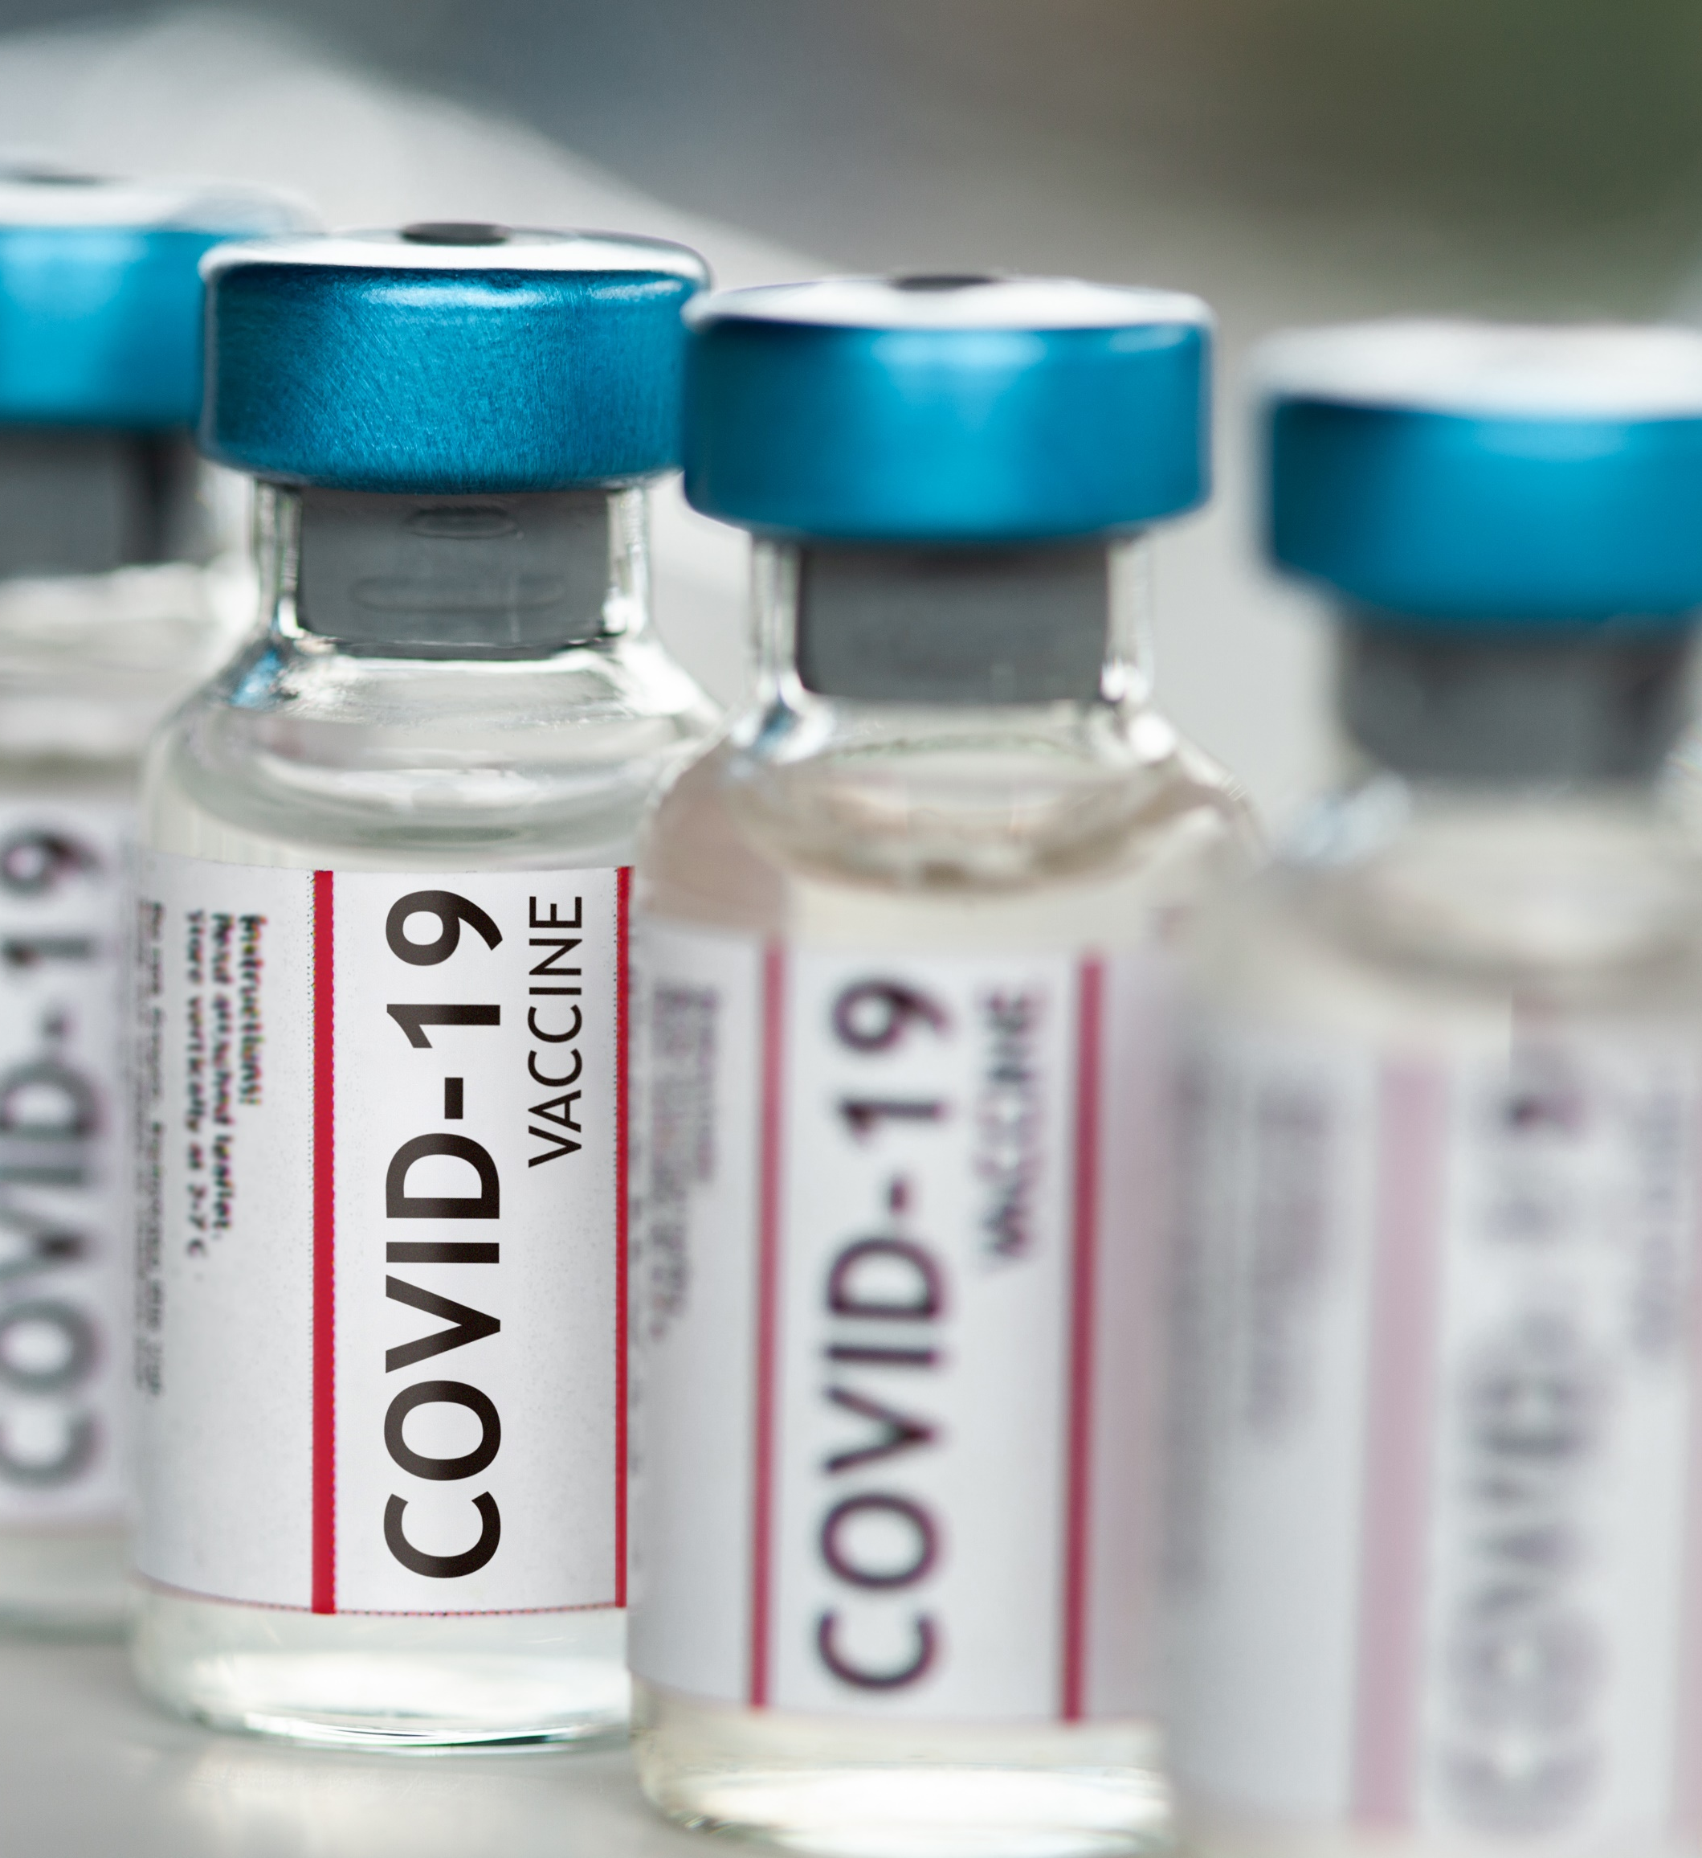

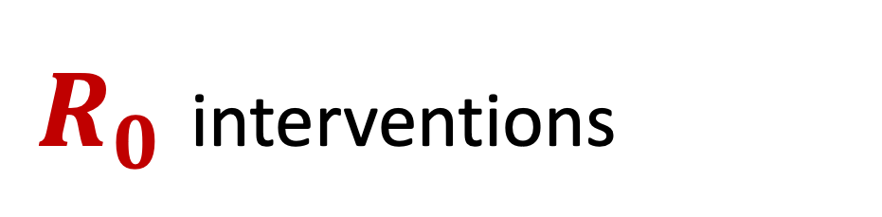

Public health interventions can be employed to reduce both R₀ and R_{E}
$R_{0}$ interventions
$R_{E}$ interventions
Social distancing
Masking
Limits to gathering sizes
Drugs that shorten the infectious period
Vaccination

Slide 77
Public health interventions can be employed to reduce both R₀ and R_{E}
$R_{0}$ interventions
$R_{E}$ interventions
Social distancing
Masking
Limits to gathering sizes
Drugs that shorten the infectious period
Vaccination

Slide 78
Vaccination and Herd Immunity

Slide 79
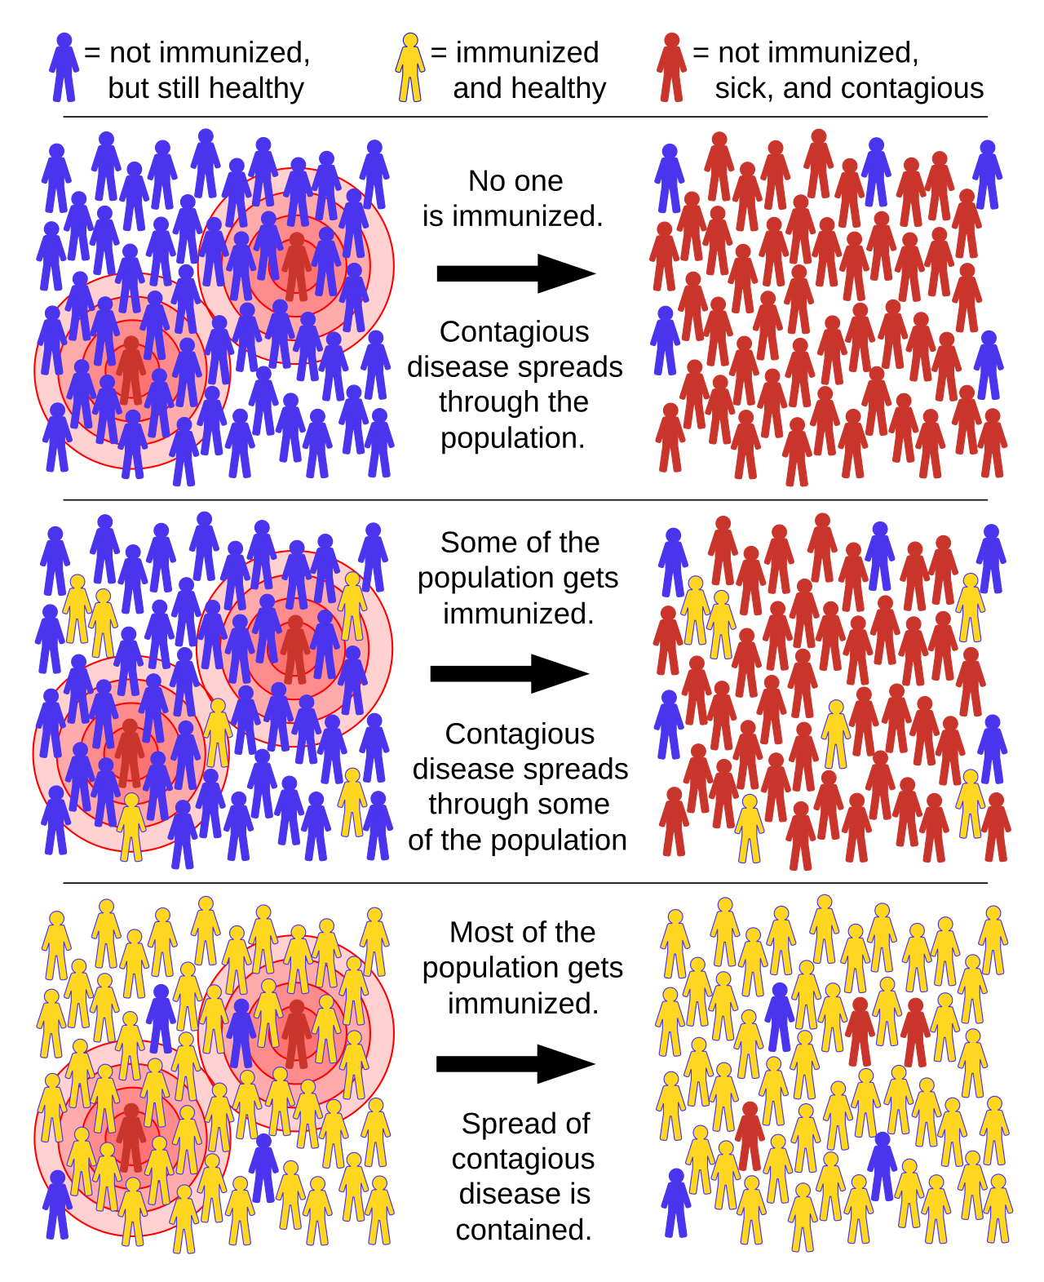
Vaccination and Herd Immunity

Slide 80
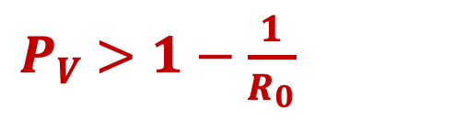
Vaccination and Herd Immunity
herd immunity threshold:
$P_{V}$ $>1−\frac{1}{R_{0}}$
P_{V} = proportion needed to vaccinate
Vaccination aims to reduce the host population below critical community size (CCS) for the pathogen of interest.
CCS, the minimum number of hosts needed to maintain endemic transmission of a pathogen indefinitely into the future, varies based on the transmissibility of the pathogen.

Slide 81
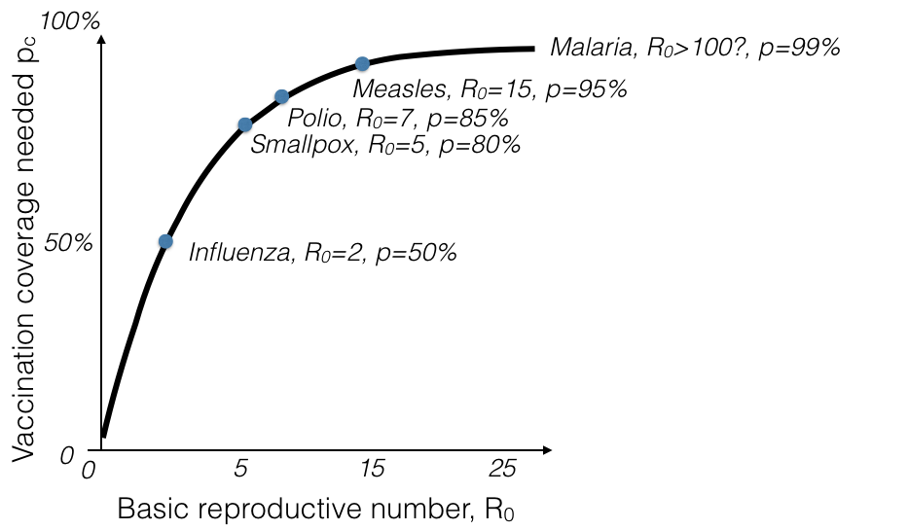

Vaccination and Herd Immunity
herd immunity threshold:
$P_{V}$ $>1−\frac{1}{R_{0}}$
The more transmissible the disease, the higher the HIT!

Slide 82
Mechanisms of disease transmission
Directly-transmitted diseases – transmitted via exchange of bodily fluids
Droplet (> 5 microns ) spread or direct contact, includes sexually-transmitted pathogens
Ex: Smallpox (Variola spp.), HIV, Mononucleosis (Epstein Barr virus)
Indirectly-transmitted diseases – transmitted via droplets retained in air
Droplets < 5 microns in diameter
Ex: Measles, COVID (SARS-CoV-2)
Vertically-transmitted pathogens – transmitted mother-to-child in utero
Ex: HIV, Herpes simplex virus, Cytomegalovirus, Rubella, Zika
Environmentally-transmitted pathogens – transmitted outside host (e.g. water, food)
Ex: Cholera (Vibrio cholerae), Salmonellosis (Salmonella spp. bacteria)
Vector-borne diseases (a type of indirect transmission) are transmitted via blood-feeding arthropod (mosquitoes, ticks, fleas)
Ex: malaria, arboviruses (dengue, yellow fever), sleeping sickness, plague

Slide 83
Mechanisms of disease transmission
Directly-transmitted diseases – transmitted via exchange of bodily fluids
Droplet (> 5 microns ) spread or direct contact, includes sexually-transmitted pathogens
Ex: Smallpox (Variola spp.), HIV, Mononucleosis (Epstein Barr virus)
Indirectly-transmitted diseases – transmitted via droplets retained in air
Droplets < 5 microns in diameter
Ex: Measles, COVID (SARS-CoV-2)
Vertically-transmitted pathogens – transmitted mother-to-child in utero
Ex: HIV, Herpes simplex virus, Cytomegalovirus, Rubella, Zika
Environmentally-transmitted pathogens – transmitted outside host (e.g. water, food)
Ex: Cholera (Vibrio cholerae), Salmonellosis (Salmonella spp. bacteria)
Vector-borne diseases (a type of indirect transmission) are transmitted via blood-feeding arthropod (mosquitoes, ticks, fleas)
Ex: malaria, arboviruses (dengue, yellow fever), sleeping sickness, plague

Slide 84
Mechanisms of disease transmission
Directly-transmitted diseases – transmitted via exchange of bodily fluids
Droplet (> 5 microns ) spread or direct contact, includes sexually-transmitted pathogens
Ex: Smallpox (Variola spp.), HIV, Mononucleosis (Epstein Barr virus)
Indirectly-transmitted diseases – transmitted via droplets retained in air
Droplets < 5 microns in diameter
Ex: Measles, COVID (SARS-CoV-2)
Vertically-transmitted pathogens – transmitted mother-to-child in utero
Ex: HIV, Herpes simplex virus, Cytomegalovirus, Rubella, Zika
Environmentally-transmitted pathogens – transmitted outside host (e.g. water, food)
Ex: Cholera (Vibrio cholerae), Salmonellosis (Salmonella spp. bacteria)
Vector-borne diseases (a type of indirect transmission) are transmitted via blood-feeding arthropod (mosquitoes, ticks, fleas)
Ex: malaria, arboviruses (dengue, yellow fever), sleeping sickness, plague

Slide 85
Mechanisms of disease transmission
Directly-transmitted diseases – transmitted via exchange of bodily fluids
Droplet (> 5 microns ) spread or direct contact, includes sexually-transmitted pathogens
Ex: Smallpox (Variola spp.), HIV, Mononucleosis (Epstein Barr virus)
Indirectly-transmitted diseases – transmitted via droplets retained in air
Droplets < 5 microns in diameter
Ex: Measles, COVID (SARS-CoV-2)
Vertically-transmitted pathogens – transmitted mother-to-child in utero
Ex: HIV, Herpes simplex virus, Cytomegalovirus, Rubella, Zika
Environmentally-transmitted pathogens – transmitted outside host (e.g. water, food)
Ex: Cholera (Vibrio cholerae), Salmonellosis (Salmonella spp. bacteria)
Vector-borne diseases (a type of indirect transmission) are transmitted via blood-feeding arthropod (mosquitoes, ticks, fleas)
Ex: malaria, arboviruses (dengue, yellow fever), sleeping sickness, plague

Slide 86
Mechanisms of disease transmission
Directly-transmitted diseases – transmitted via exchange of bodily fluids
Droplet (> 5 microns ) spread or direct contact, includes sexually-transmitted pathogens
Ex: Smallpox (Variola spp.), HIV, Mononucleosis (Epstein Barr virus)
Indirectly-transmitted diseases – transmitted via droplets retained in air
Droplets < 5 microns in diameter
Ex: Measles, COVID (SARS-CoV-2)
Vertically-transmitted pathogens – transmitted mother-to-child in utero
Ex: HIV, Herpes simplex virus, Cytomegalovirus, Rubella, Zika
Environmentally-transmitted pathogens – transmitted outside host (e.g. water, food)
Ex: Cholera (Vibrio cholerae), Salmonellosis (Salmonella spp. bacteria)
Vector-borne diseases (a type of indirect transmission) are transmitted via blood-feeding arthropod (mosquitoes, ticks, fleas)
Ex: malaria, arboviruses (dengue, yellow fever), sleeping sickness, plague

Slide 87
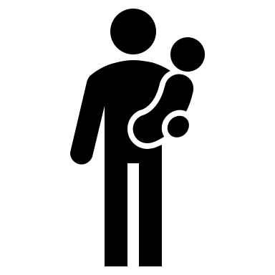
Zoonosis is the transmission of a pathogen from a wildlife reservoir host to a human target host population.
maintenance
population
(> critical community size, CCS)
human population
non-maintenance population
(< CCS)
reservoir population
Lembo et al. 2008. Journal of Animal Ecology
Haydon et al. 2002. Emerging Infectious Diseases.

Slide 88
Zoonosis is the transmission of a pathogen from a wildlife reservoir host to a human target host population.
maintenance
population
(> critical community size, CCS)
human population
non-maintenance population
(< CCS)
Can occur directly (e.g. SARS-CoV-2, rabies), or via vector (e.g. plague)
Animal hosts are not vectors!
reservoir population
Lembo et al. 2008. Journal of Animal Ecology
Haydon et al. 2002. Emerging Infectious Diseases.

Slide 89


Zoonosis is the transmission of a pathogen from a wildlife reservoir host to a human target host population.
maintenance
population
(> CCS)
human population
non-maintenance population
(< CCS)
example: rabies
reservoir population
Lembo et al. 2008. Journal of Animal Ecology
Haydon et al. 2002. Emerging Infectious Diseases.

